Slide 1
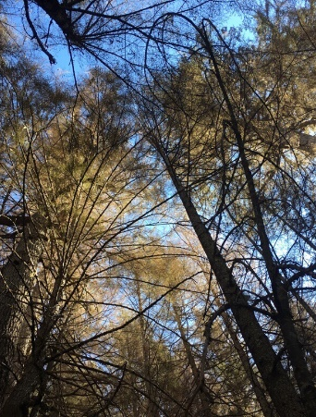
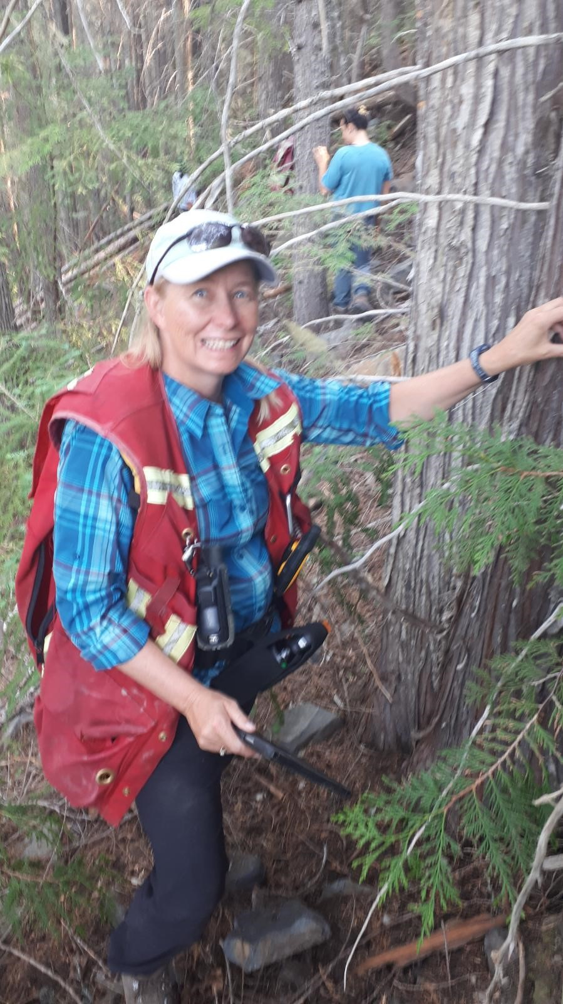
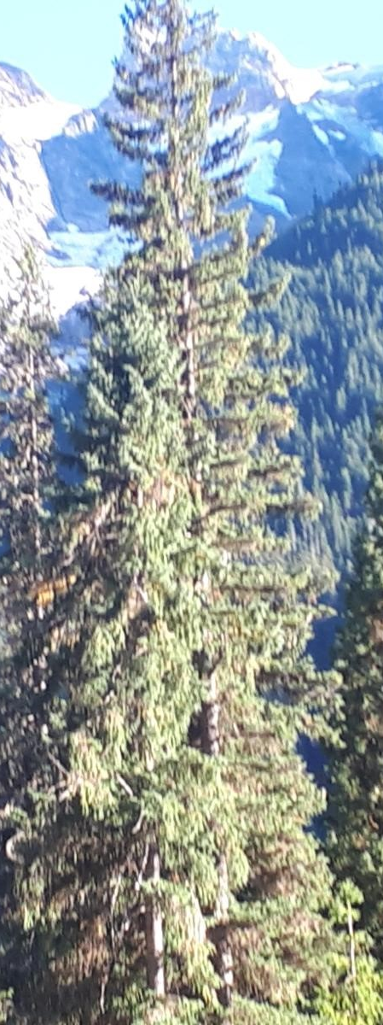
KBR Entomology Update 2021
Marnie Duthie-Holt
Regional Entomologist
November 3, 2021

Slide 2
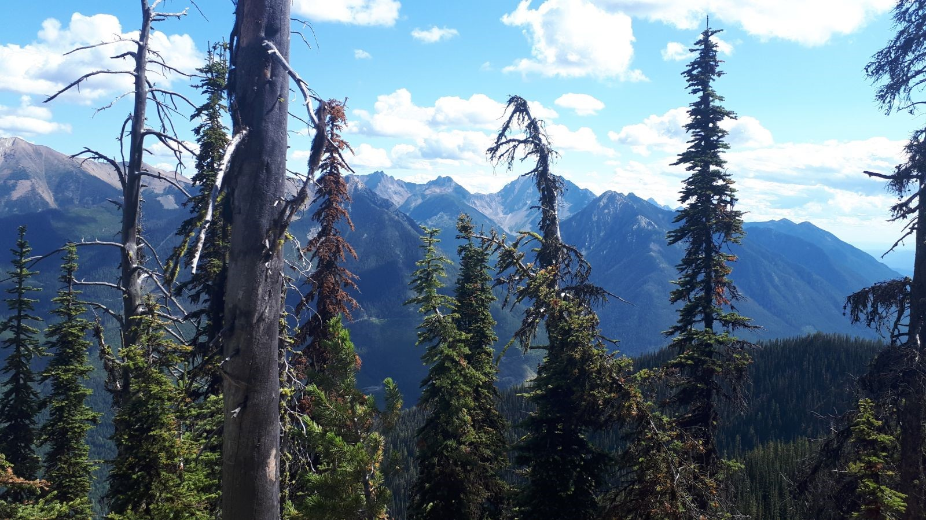
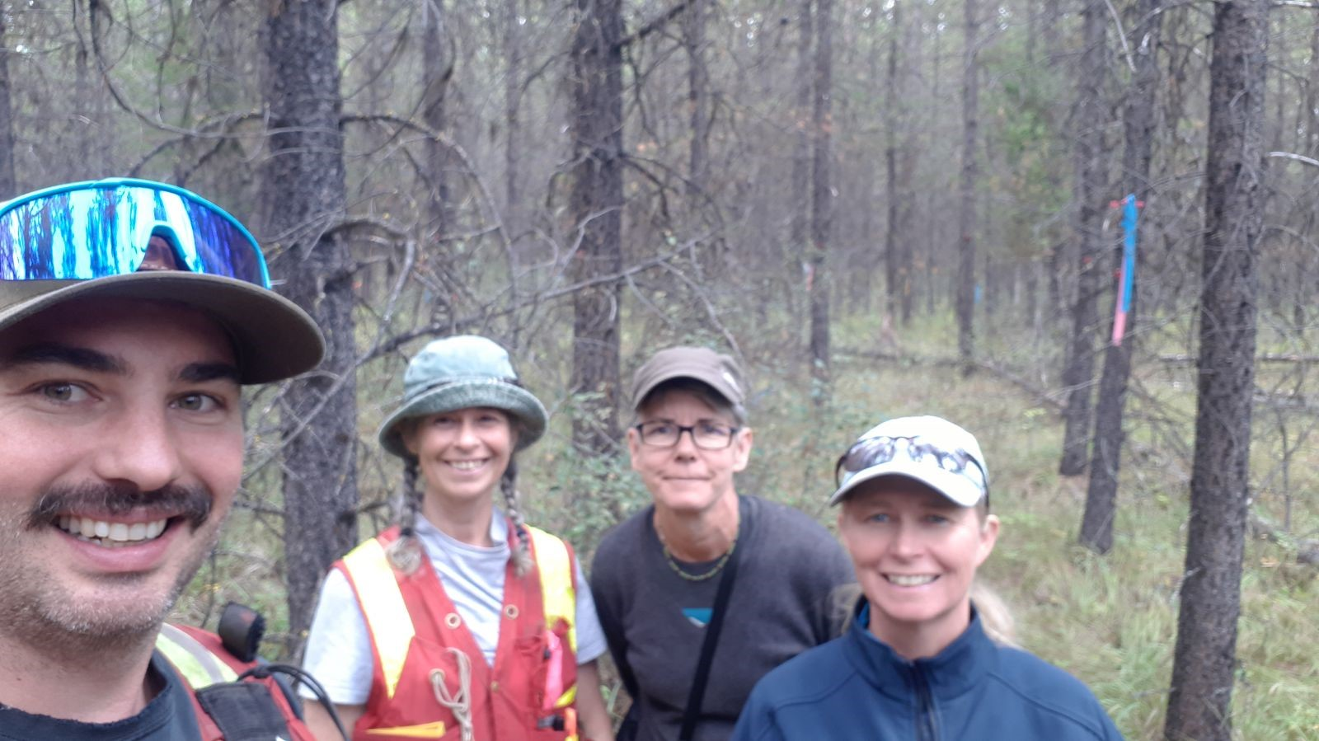
Kootenay Boundary Regional Overview
AOS
Defoliators
Bark Beetles
Monitoring
Training and Extension
Successes and challenges

Slide 3
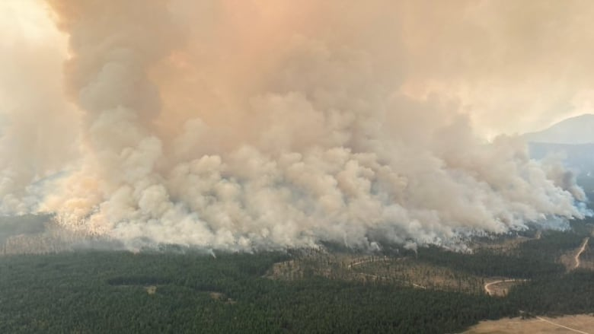
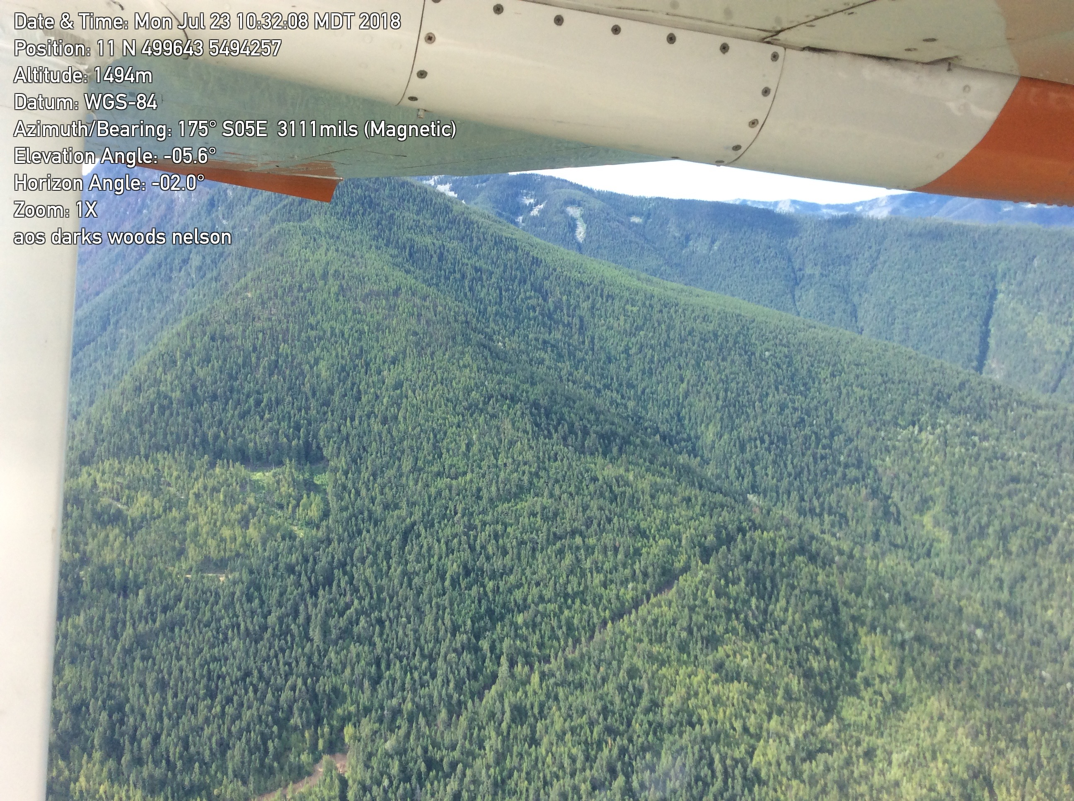
Aerial Overview Surveys
Positives
Negatives
Came in under budget
Better able to capture defoliator incidence later in season
Aircraft provider and surveyor one contract – no issues with availability
Smoke/fire delays for 5 weeks
Re-flying some areas
Delay in data final product

Slide 4
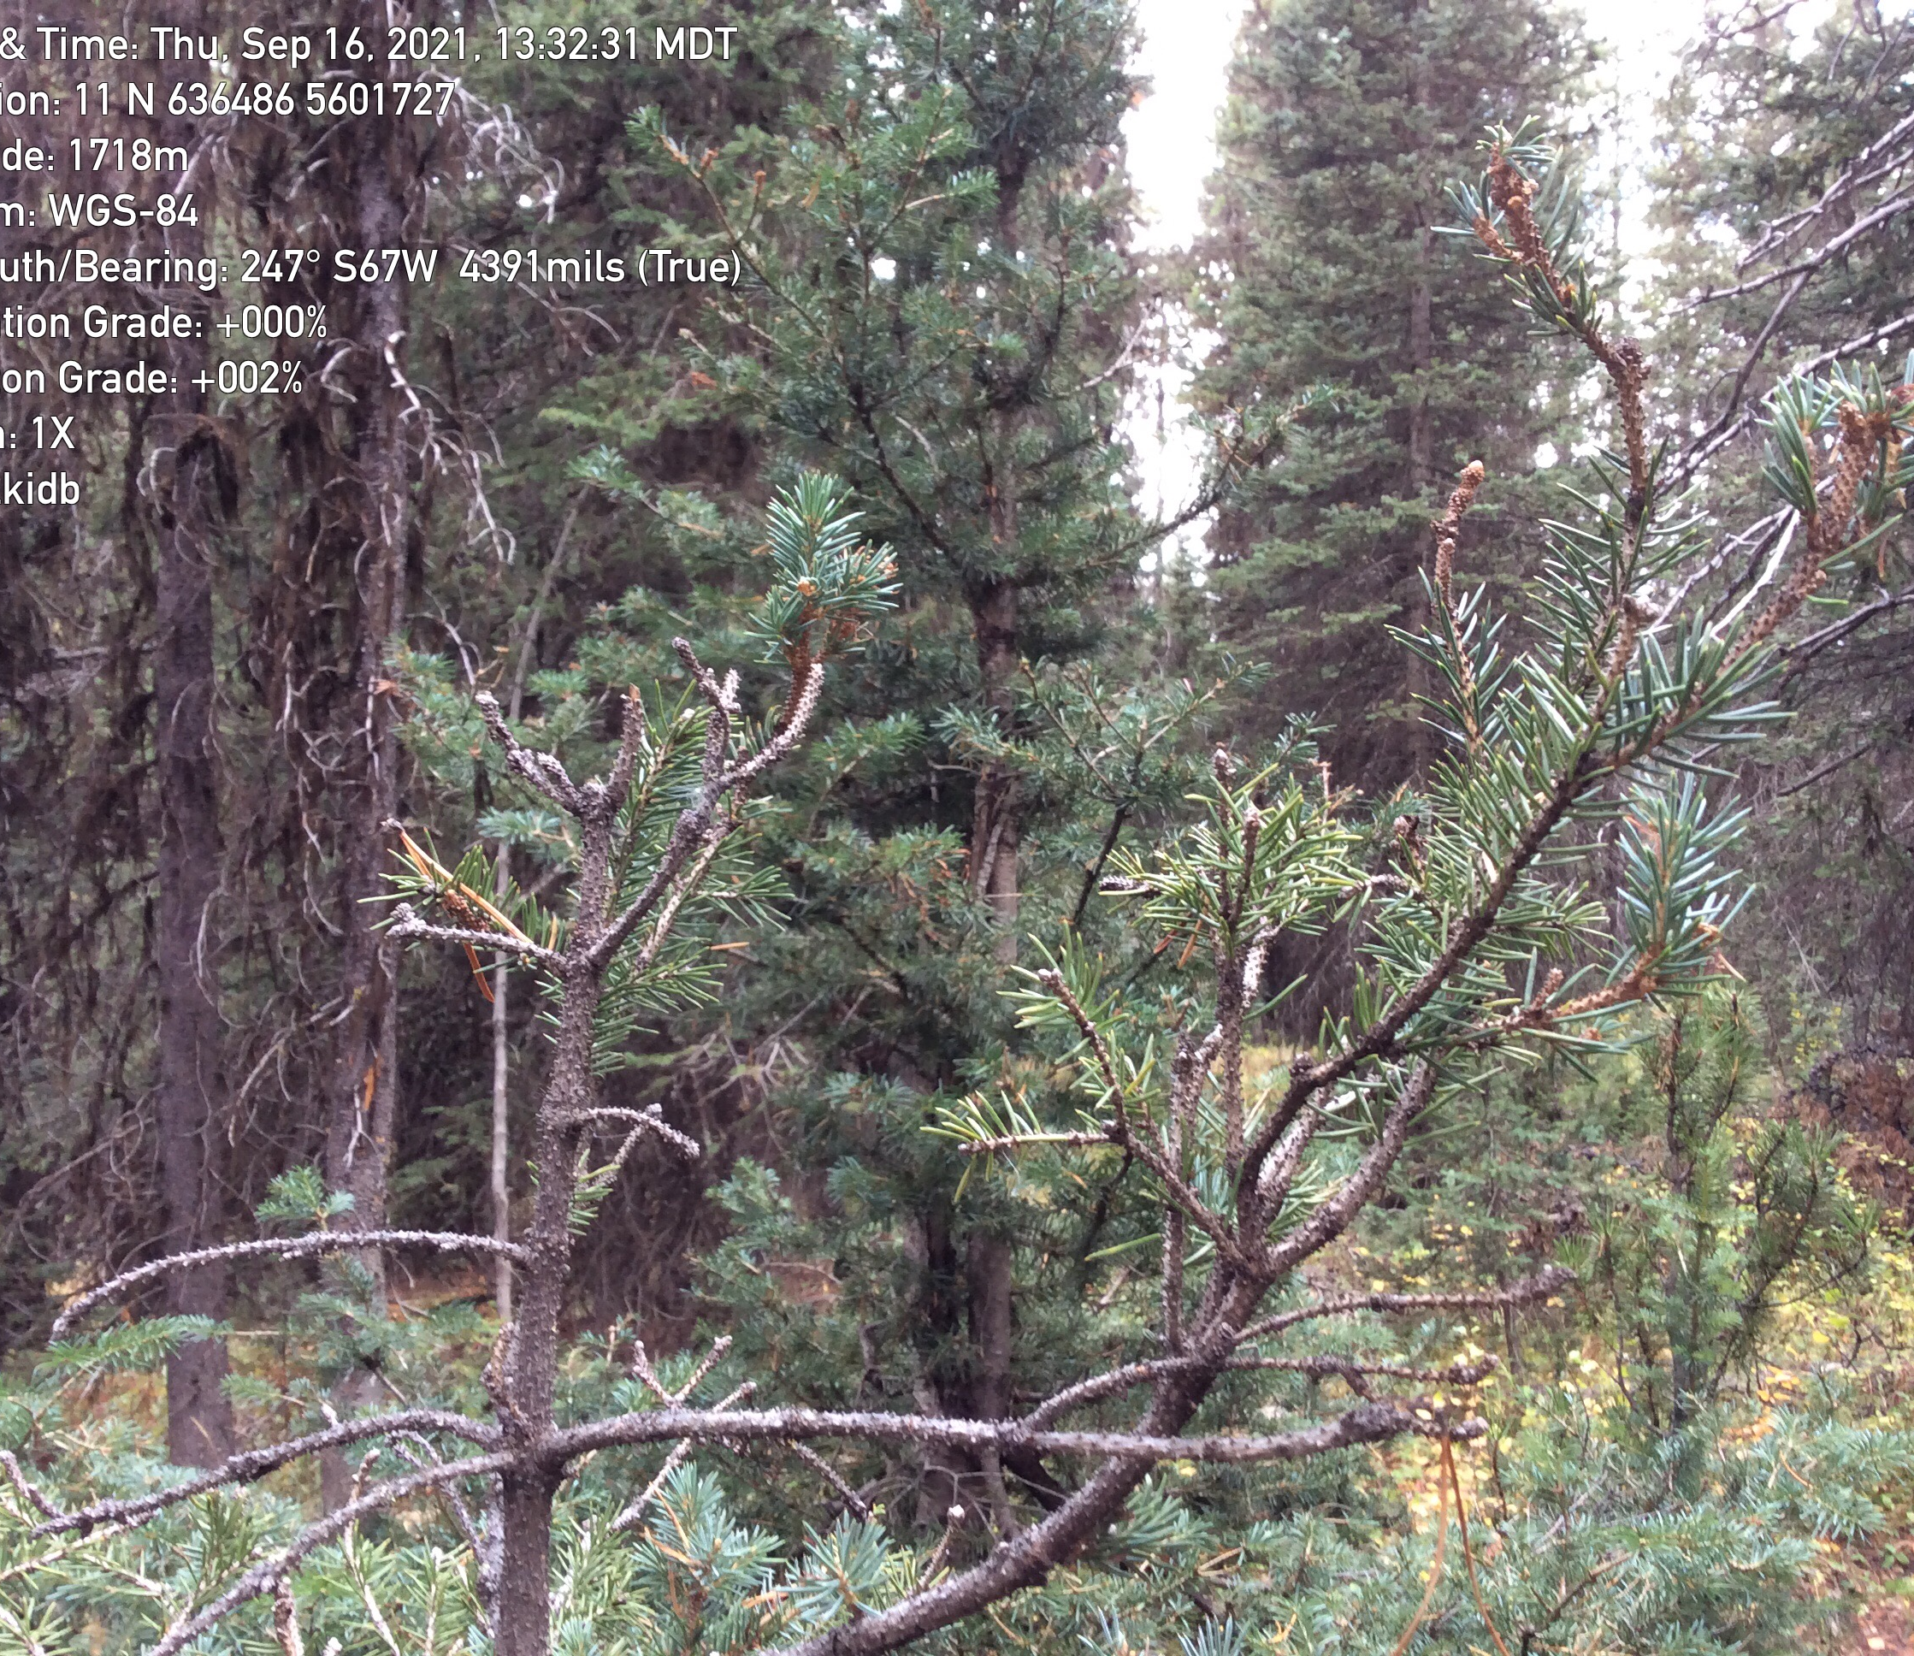
Defoliators
Douglas-fir tussock moth
Western spruce budworm
Western hemlock looper
2-year cycle budworm
Black army cutworm
Lymantria

Slide 5
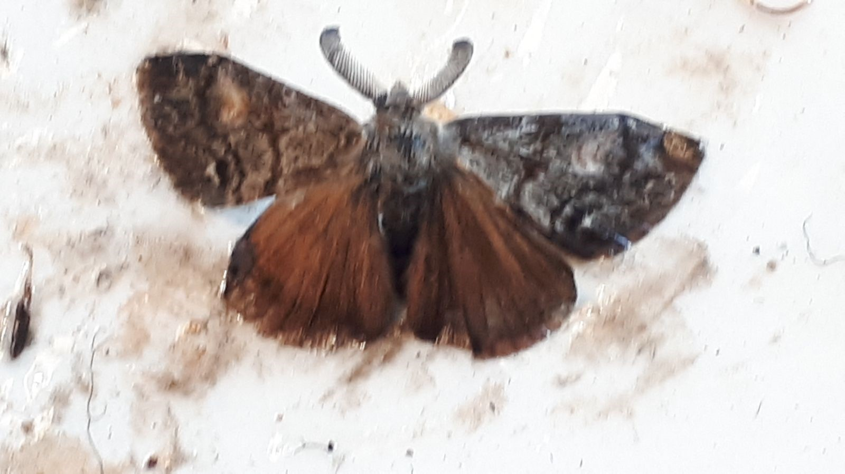
Defoliators: Douglas-fir tussock moth
Douglas-fir tussock moth
Population was building 2018-2020, then collapsed
HEAT DOME???
Trap counts low – average 0.3 moths/ trap over 9 PSP trapping sites

Slide 6
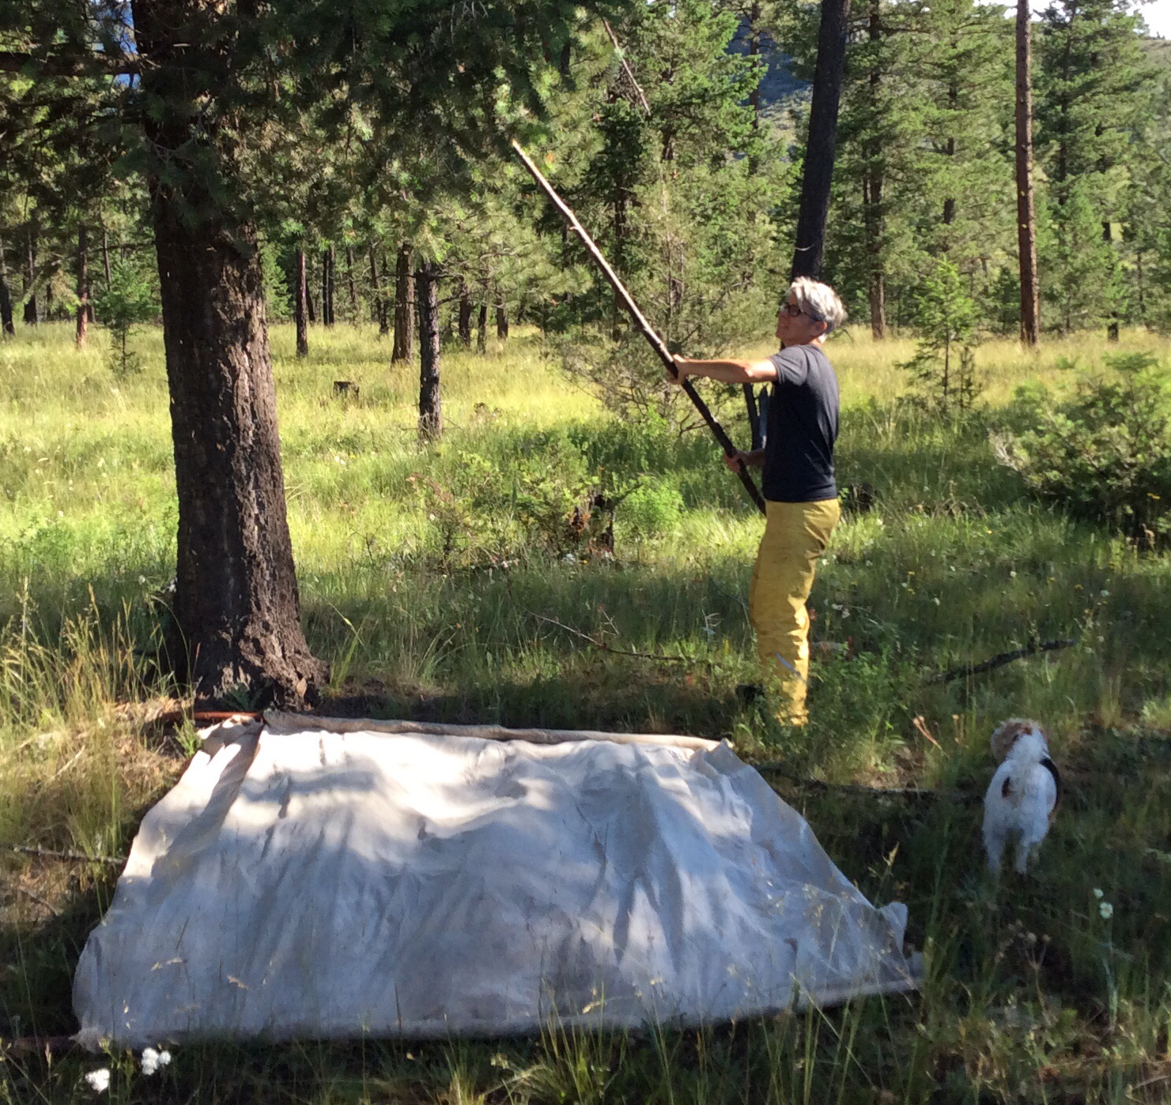
3 tree beating – larval sampling
All larval populations low in 2021 (IDW, IDL, IDZ, IDT, IDG)

Slide 7
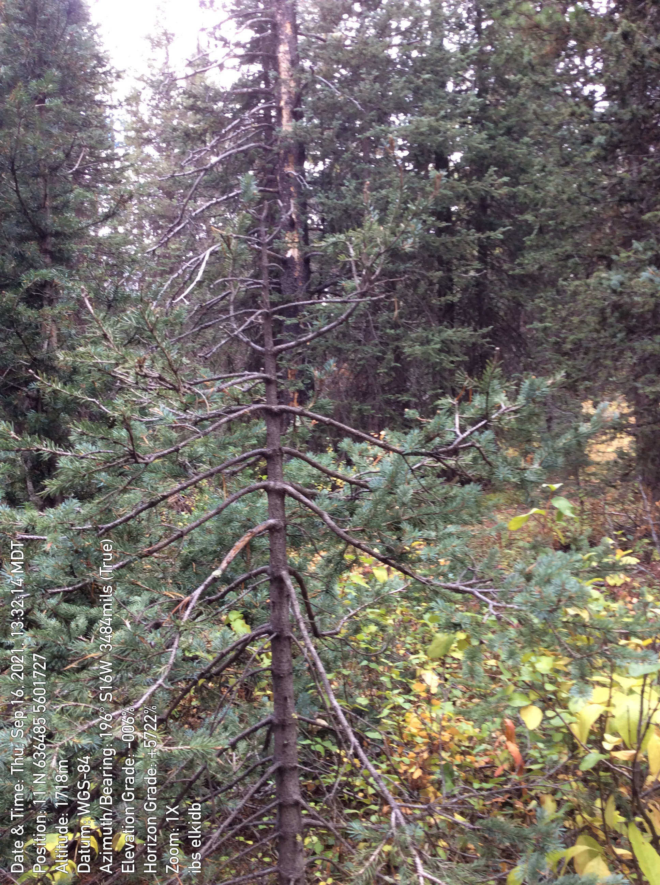
Defoliators: 2 year cycle budworm
Chronic issue
Wiping out understory Sx/ Bl
Stress to mature stand – increasing IBS

Slide 8
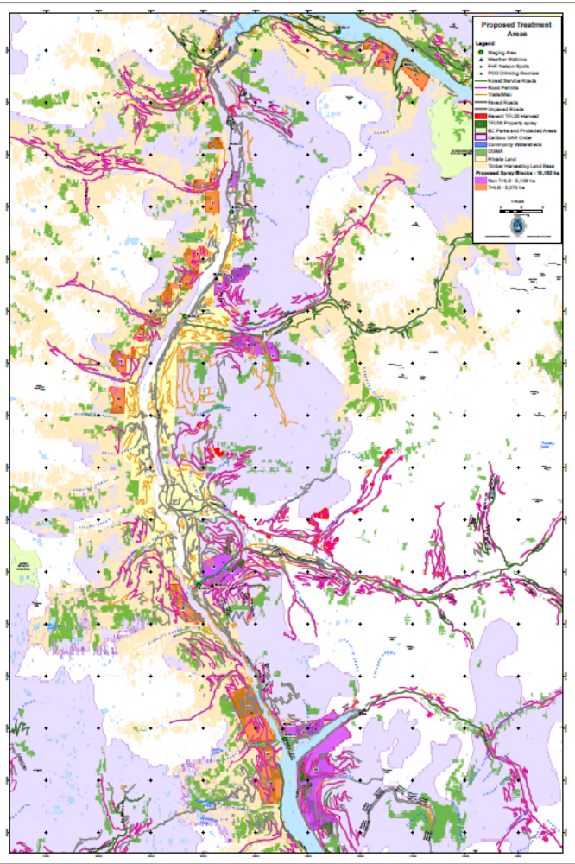
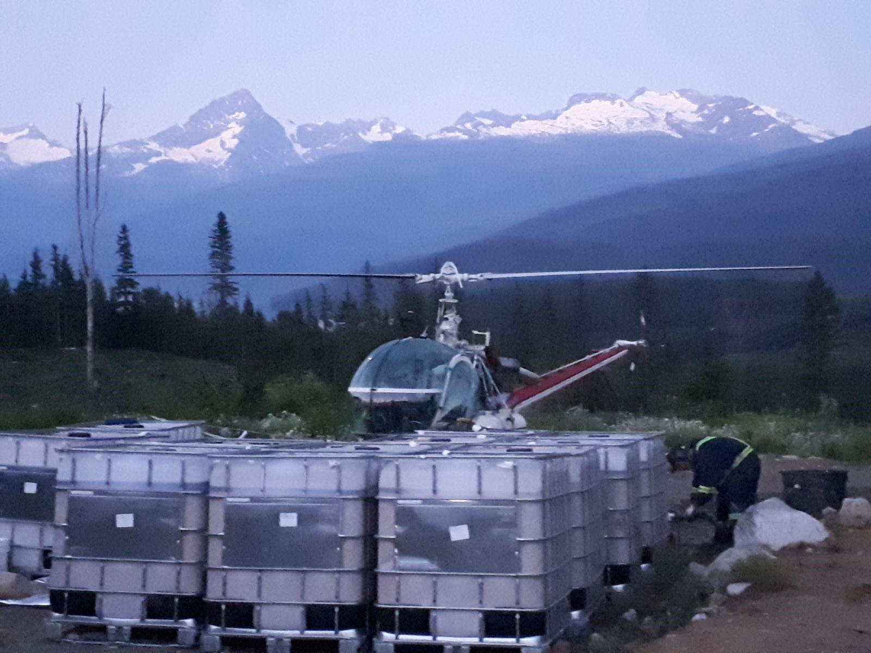
Western Hemlock Looper aerial sprays
2021
10,182.83 ha sprayed with Btk from helicopters
over 25 blocks; 5 staging sites
About half in caribou GAR areas (Non-THLB) funded by FCI

Slide 9
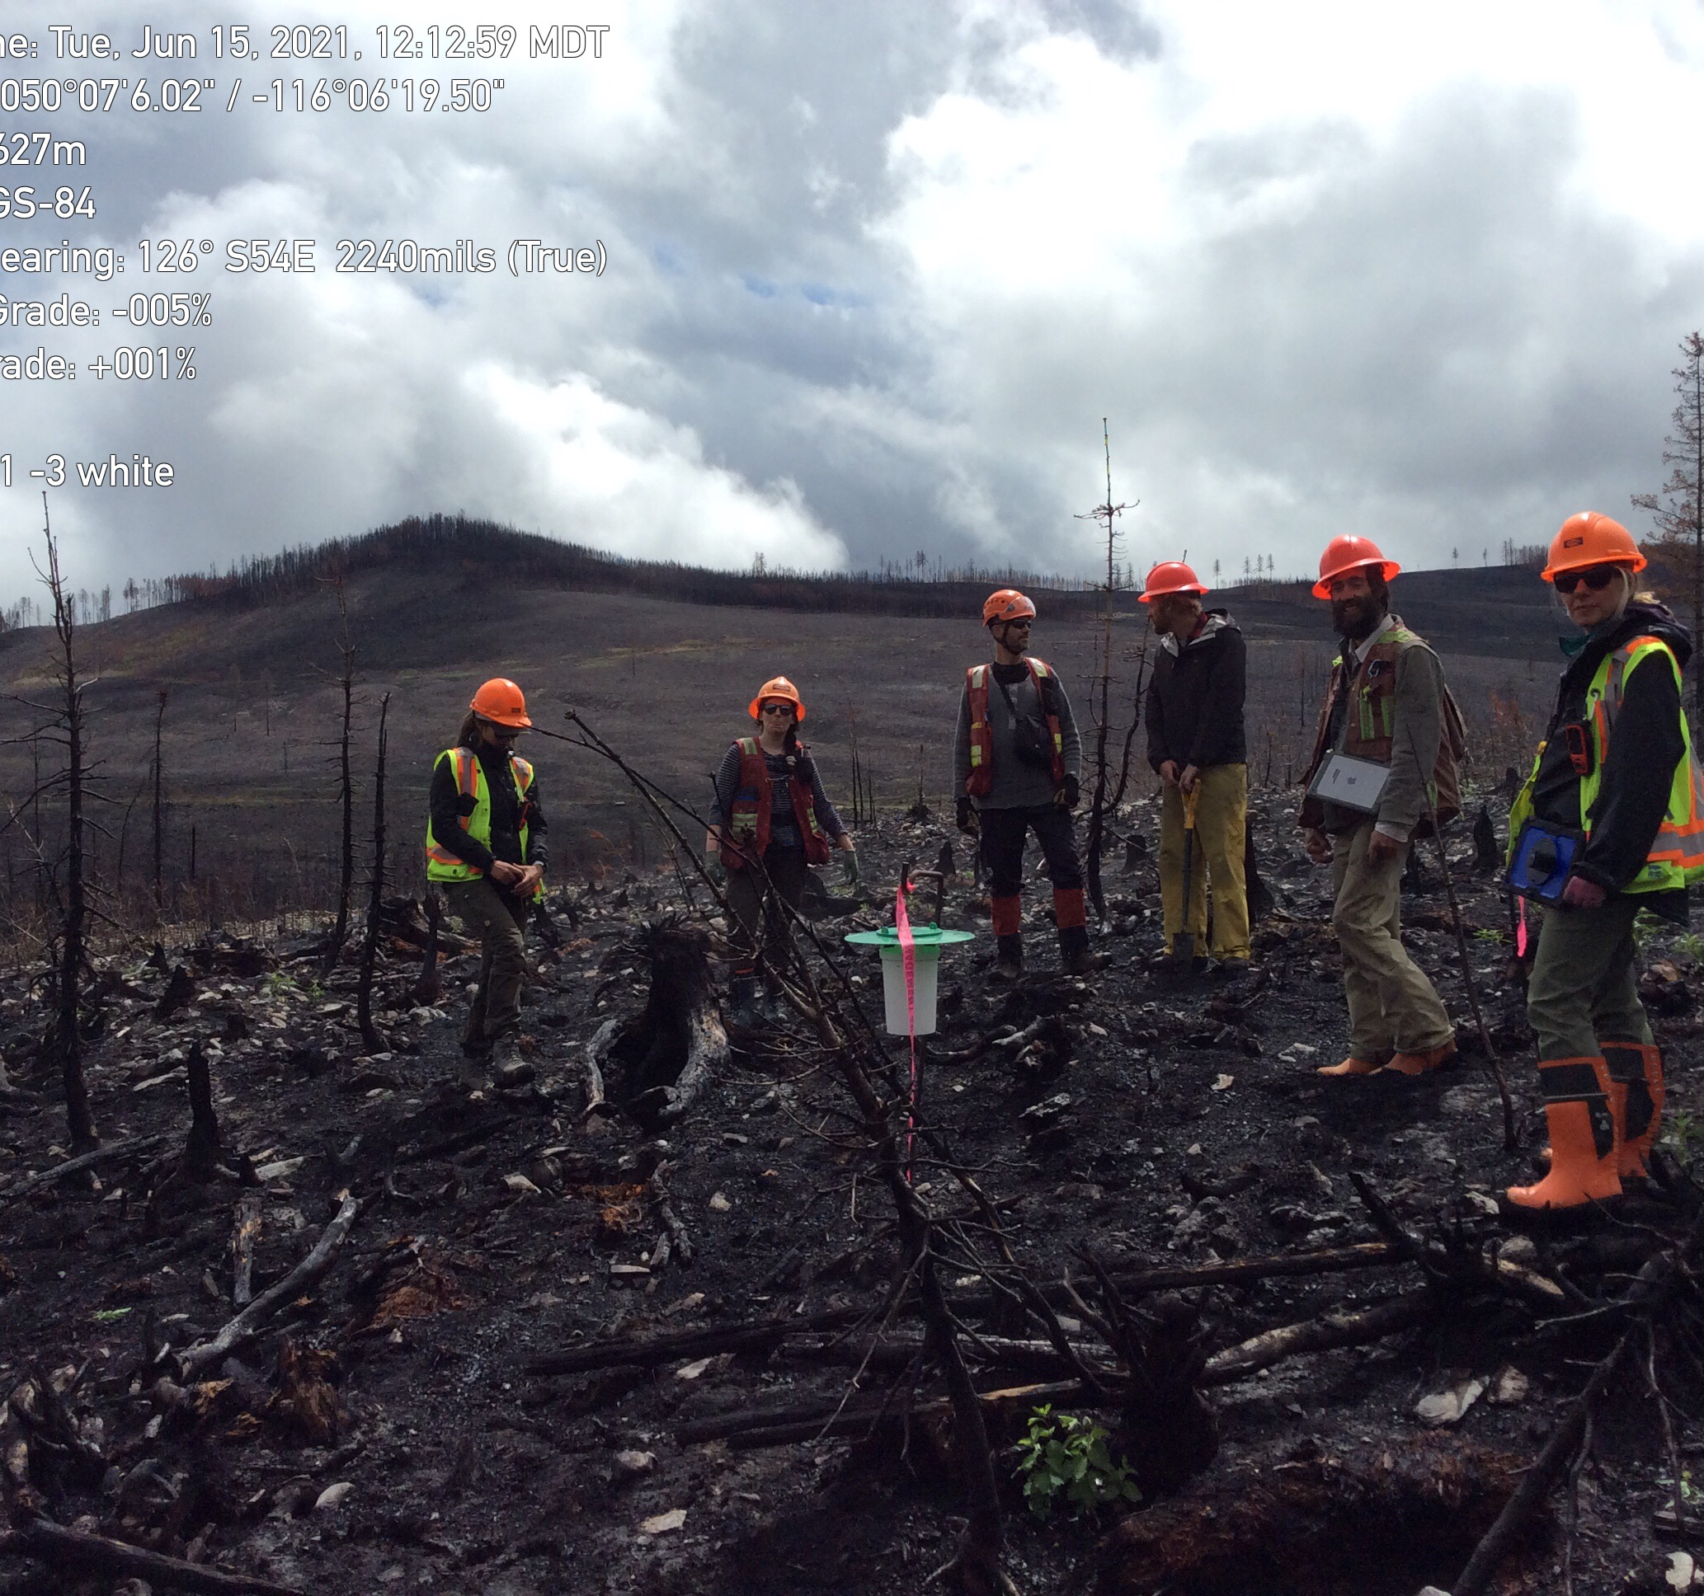
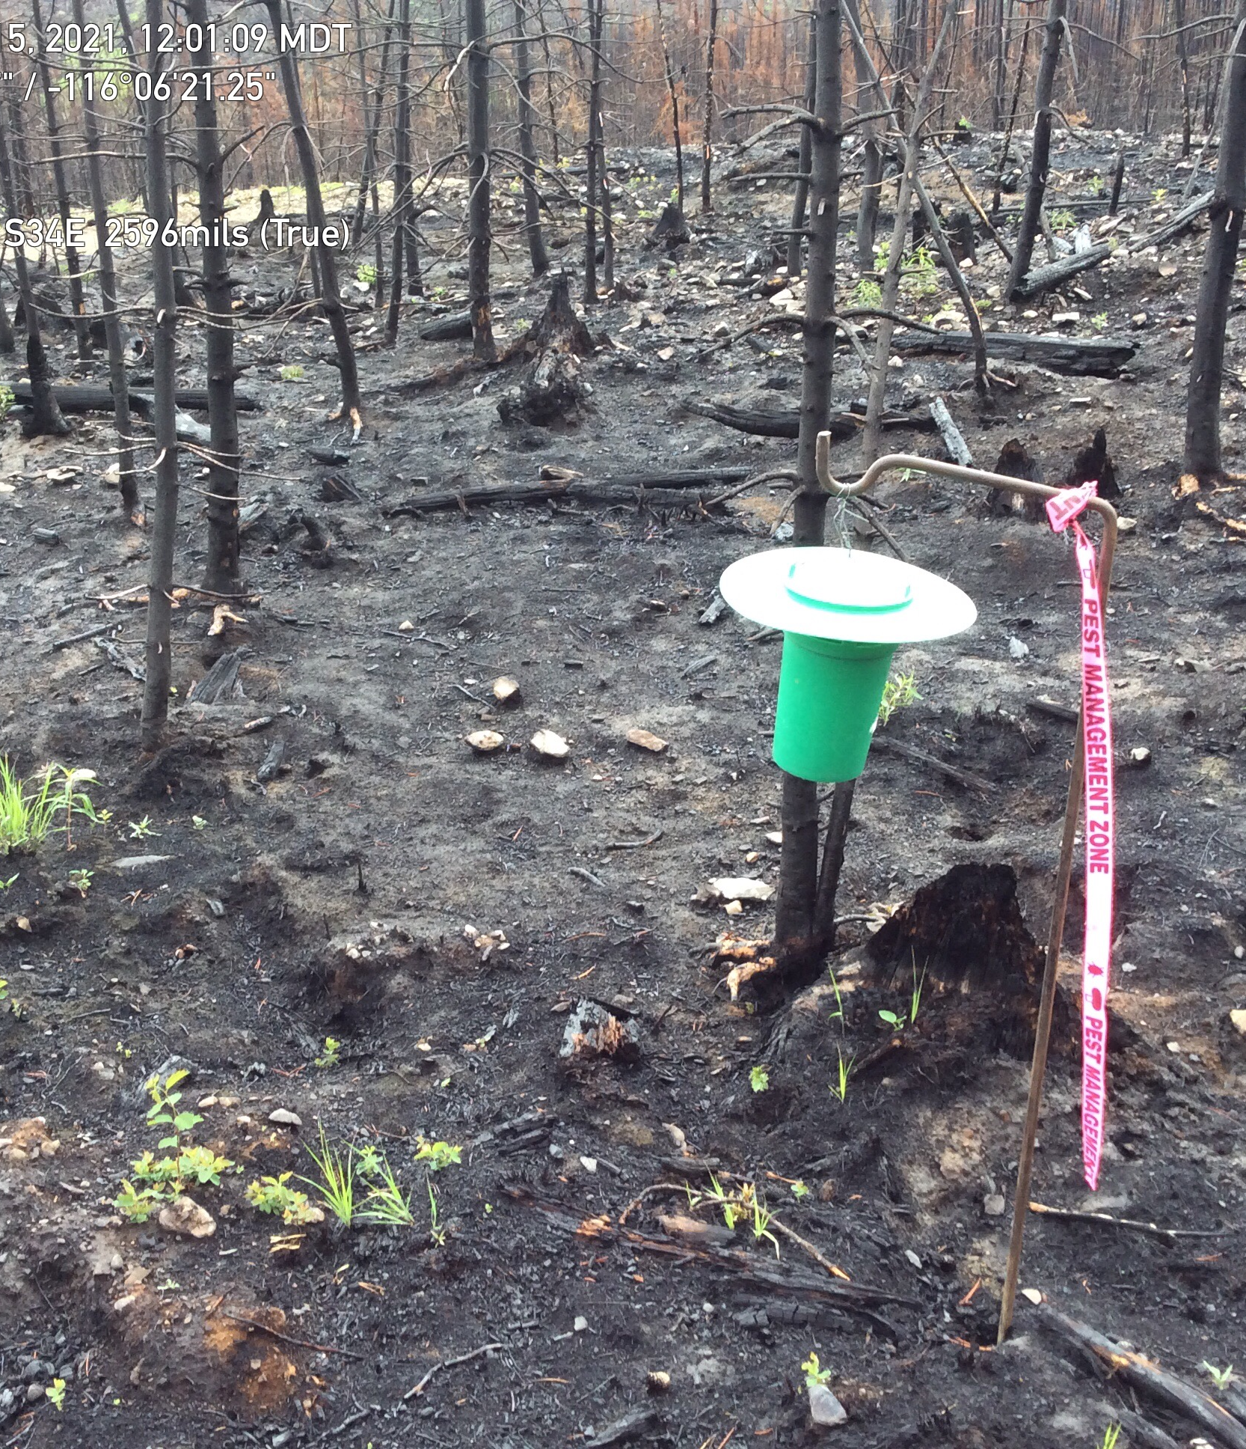
Black army cutworm
Field trip with District, BCTS, Canfor, FCI
Trap set up Doctor Creek Fire (2020); Meachan Fire (2018)
Bigger program in DSE next year

Slide 10
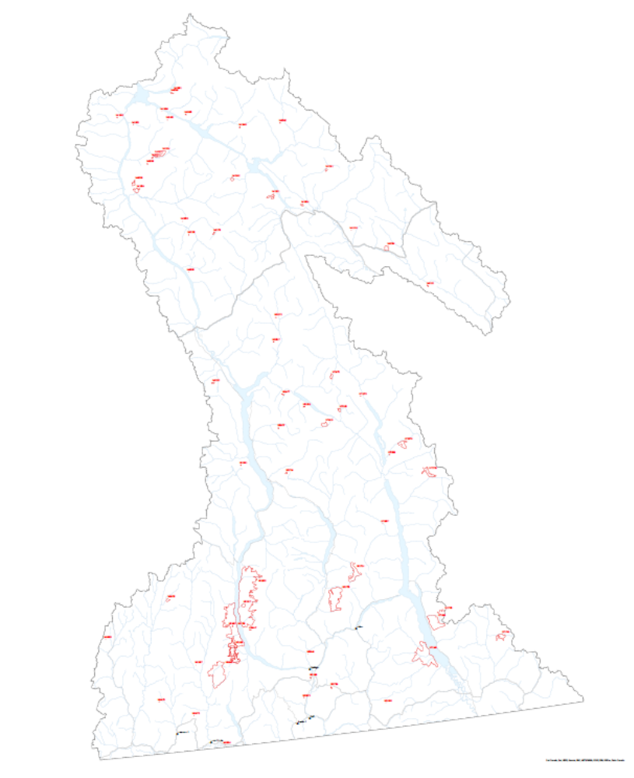
Fire and Forest Health (IBD and BAC)
Douglas-fir beetle
  Overlay fire severity, IBD hazard and IBD incidence
  Salvage opportunities
  Funnel trapping
Black army cutworm
  Moth trapping
  Delays in planting

Slide 11
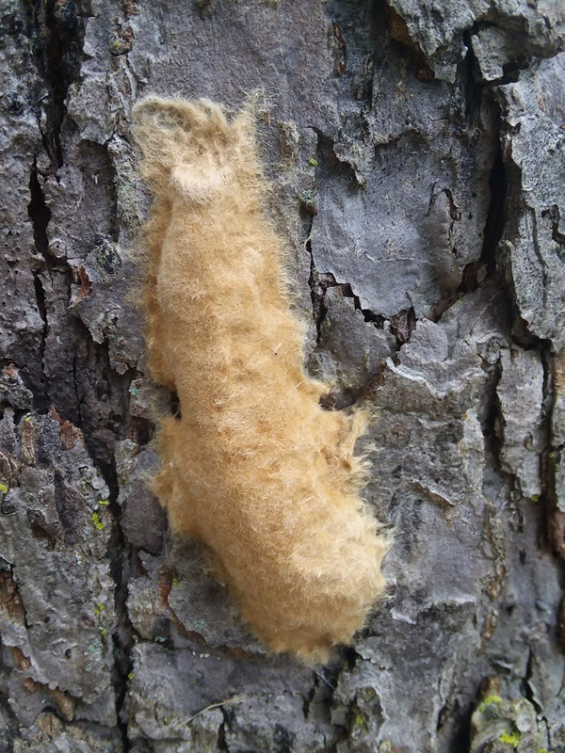
Lymantria moth Castlegar: Sequence of Events
Year | What was done | Results
2018 | Regional trapping program | 3 moths trapped - Pass Creek area
2019 | delamination grid of an additional 43 traps | 13 moths caught in 5 traps; one trap caught 9 moths 4 traps caught singles
2019 | Egg mass sampling conducted in fall (Regional Ent/ CFIA) | No egg masses located – needle in hay stack
2020 | Open House – Jan 23, 2020 | Positive response
 | Spray May 13, May 26, and June 3
2021 | Only one moth caught outside of spray | Success!

Slide 12
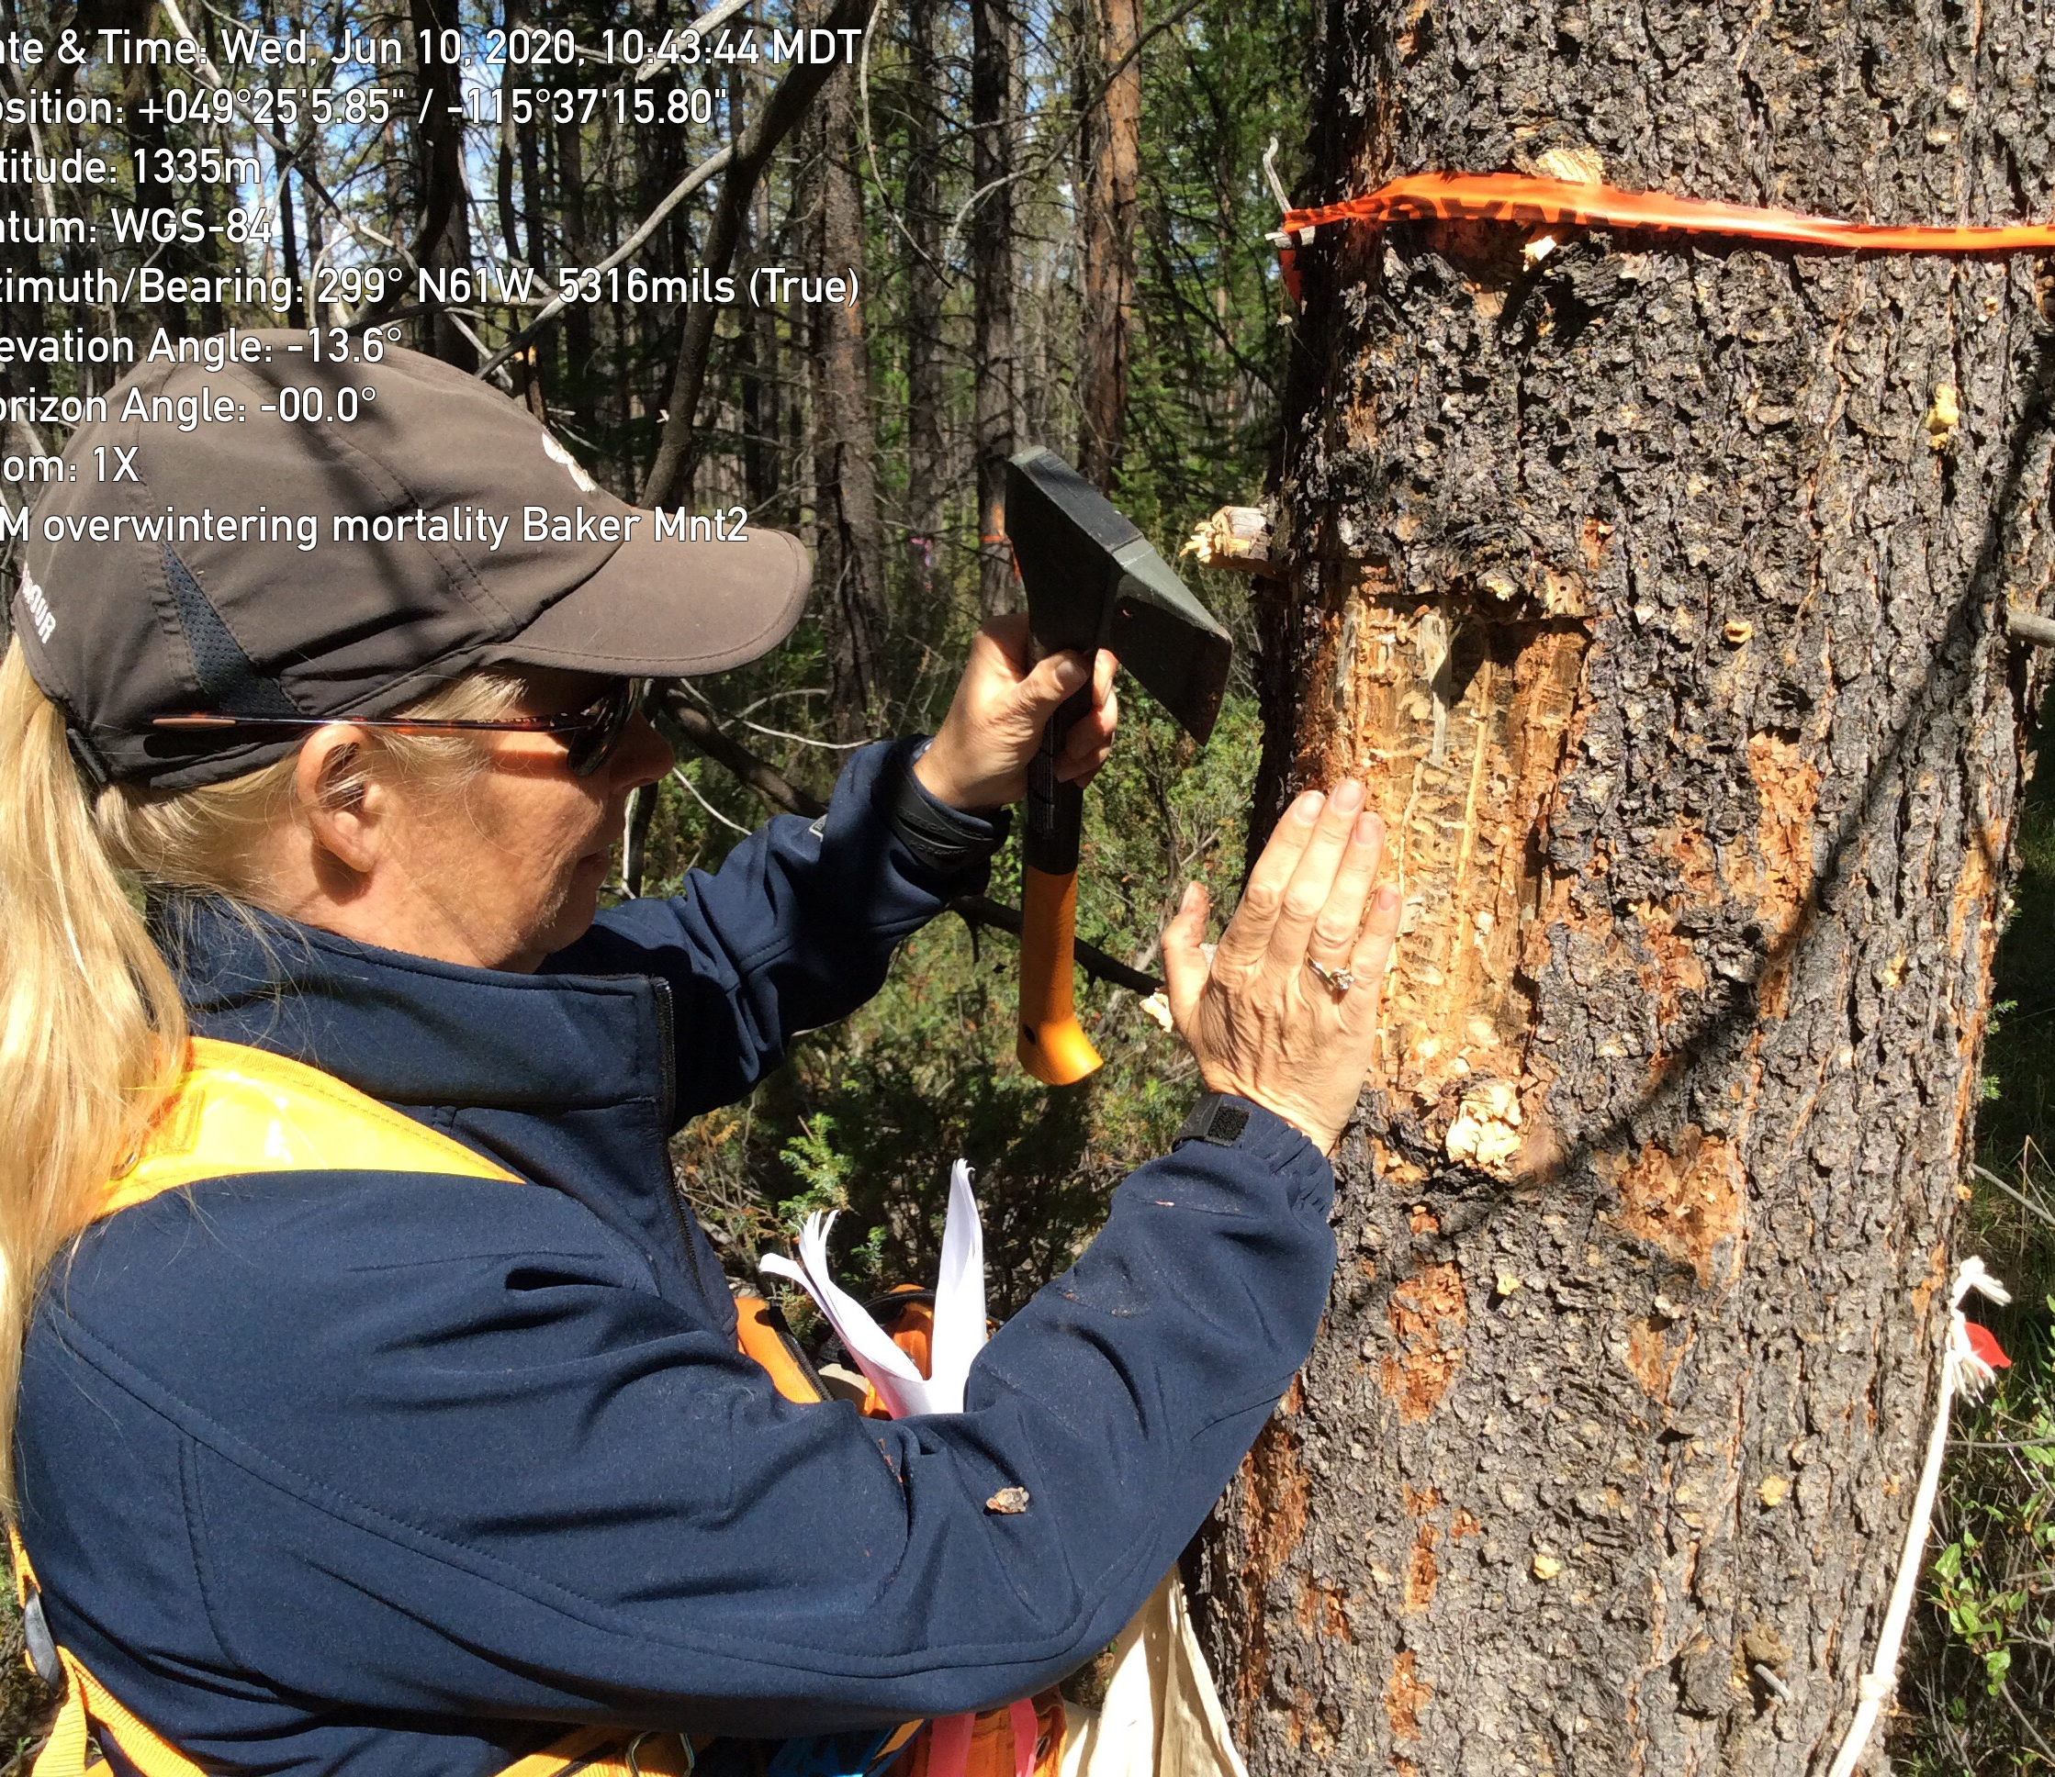
Bark Beetles
Fab 4 all thriving in KBR
IBD – most challenging for control, direct conflict with many constraints (drought, blowdown, Armillaria all causing stress)
IBM – increasing related to smaller stands drought stressed
IBS – increasing populations – lack of harvesting power
IBB – lack of control

Slide 13
Douglas-fir beetle 2010-2021
Drought, fires, constraints
AR biggest increase 2,000ha
BO reduced
CR 1,243 increase
GO doubled
IN reduced
KL 813 ha increase
RE doubled

Slide 14
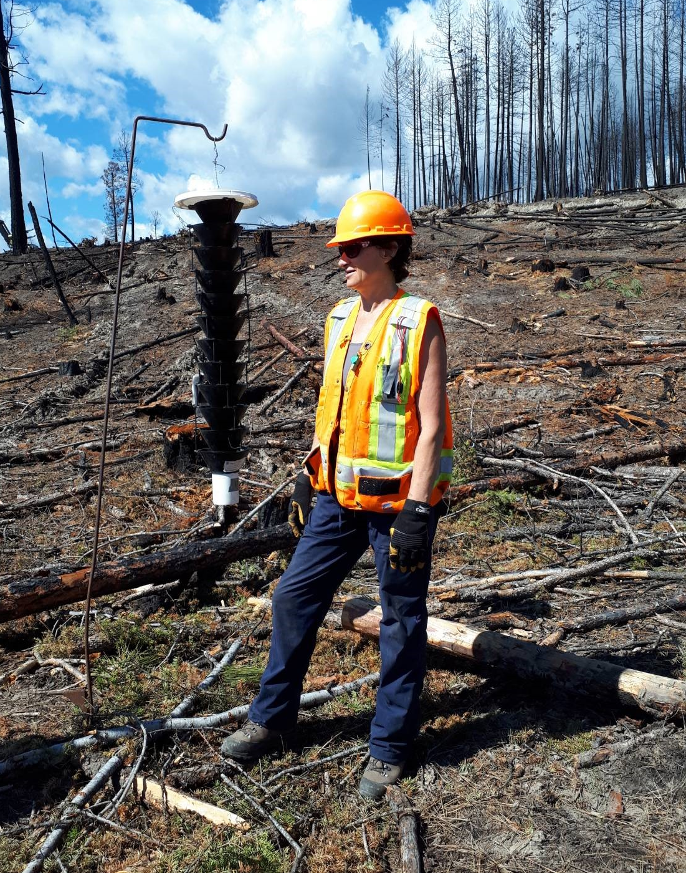
IBD Funnel Trapping Program
Extensive trapping program in both Selkirk and Rocky Mountain Districts focusing on post fire mop up

Slide 15
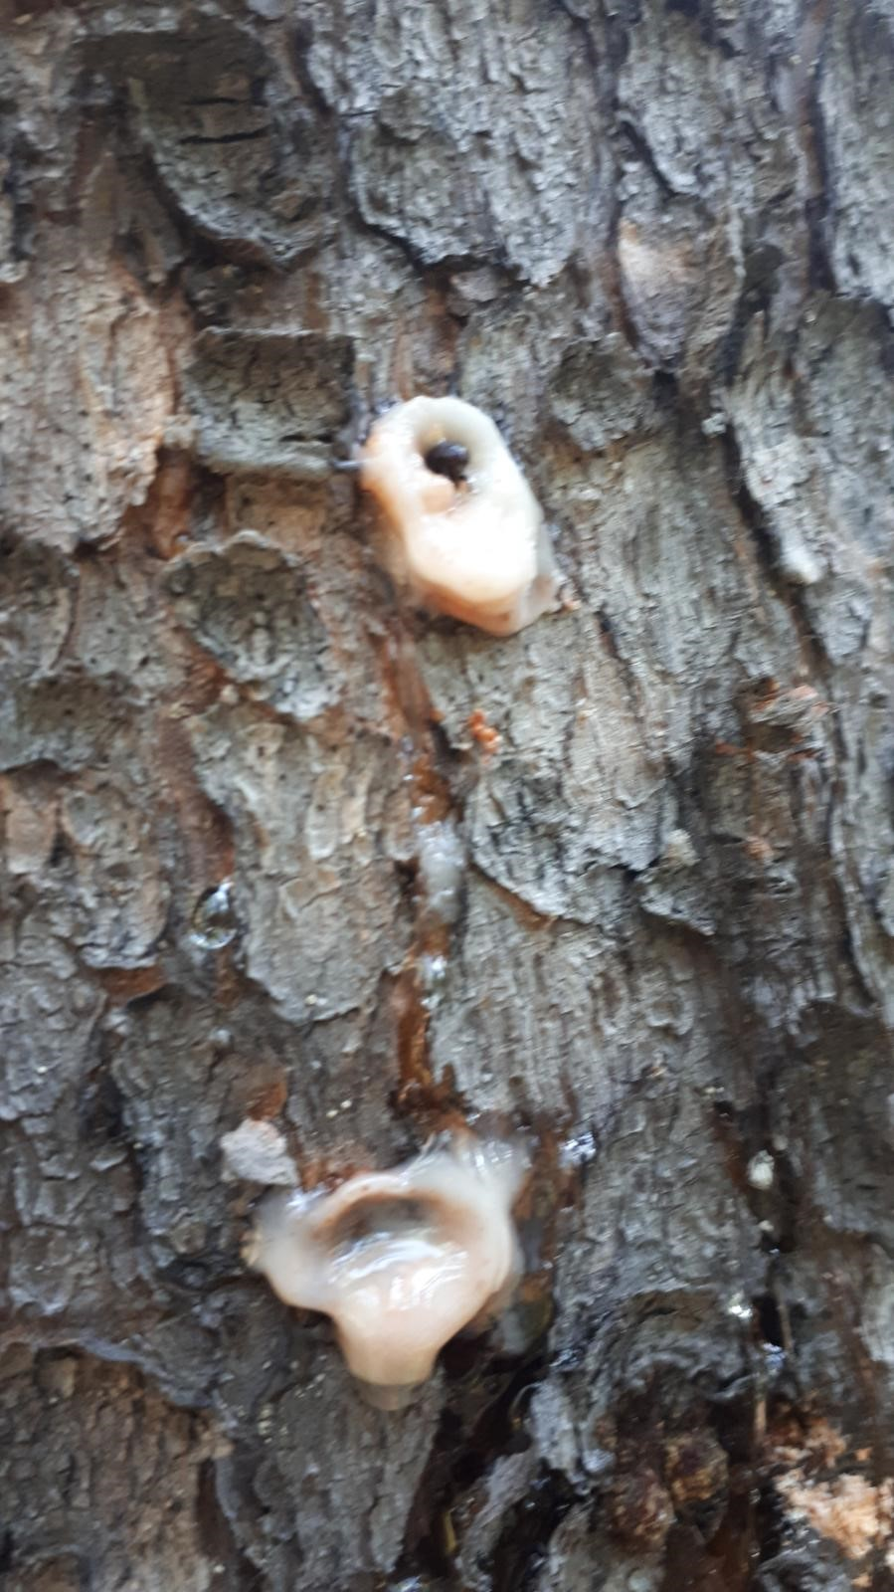
Mountain pine beetle 2010-2021
CR biggest increase (small stands associated with drought; Pa)
GO & IN still high

Slide 16
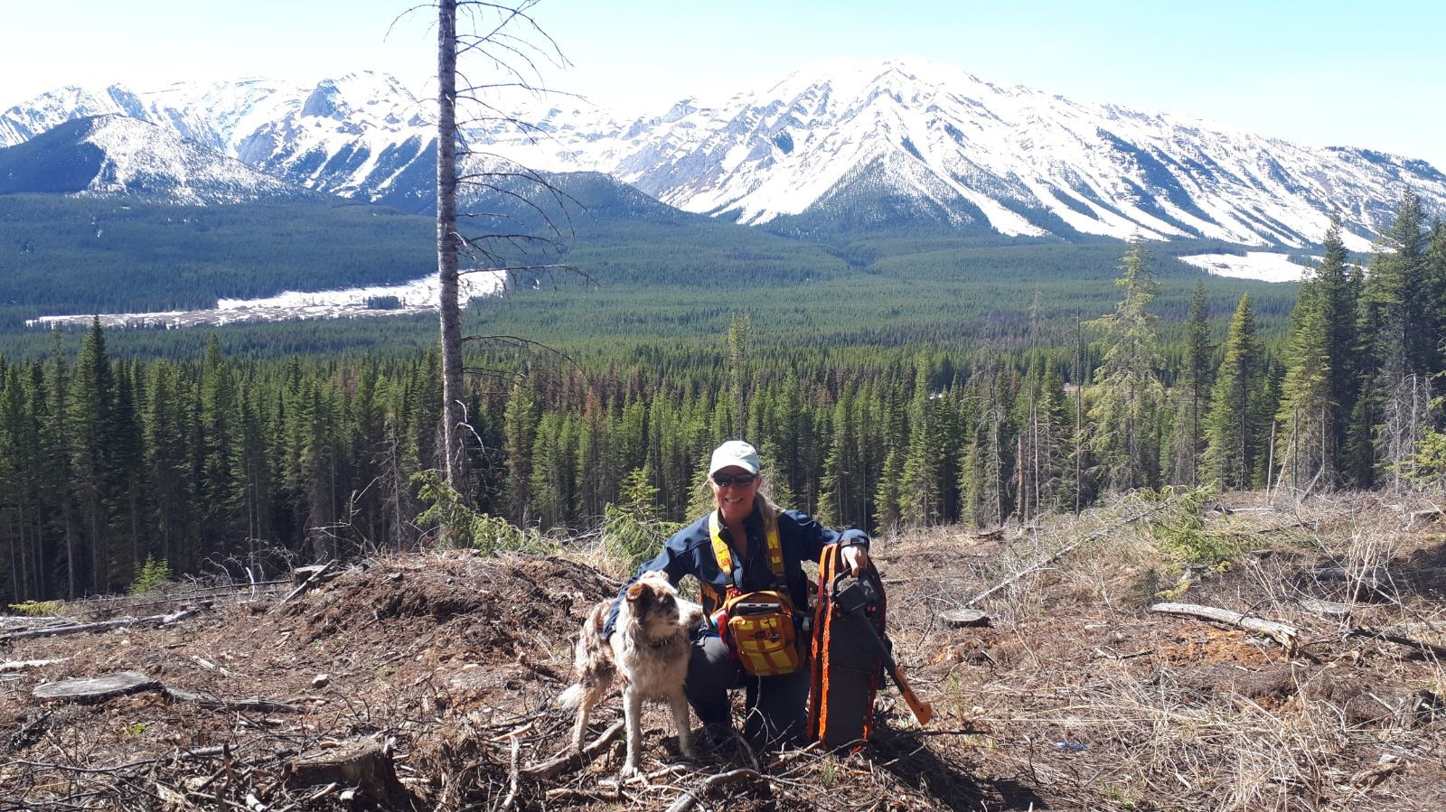
Spruce beetle 2010-2021
CR & GO high

Slide 17
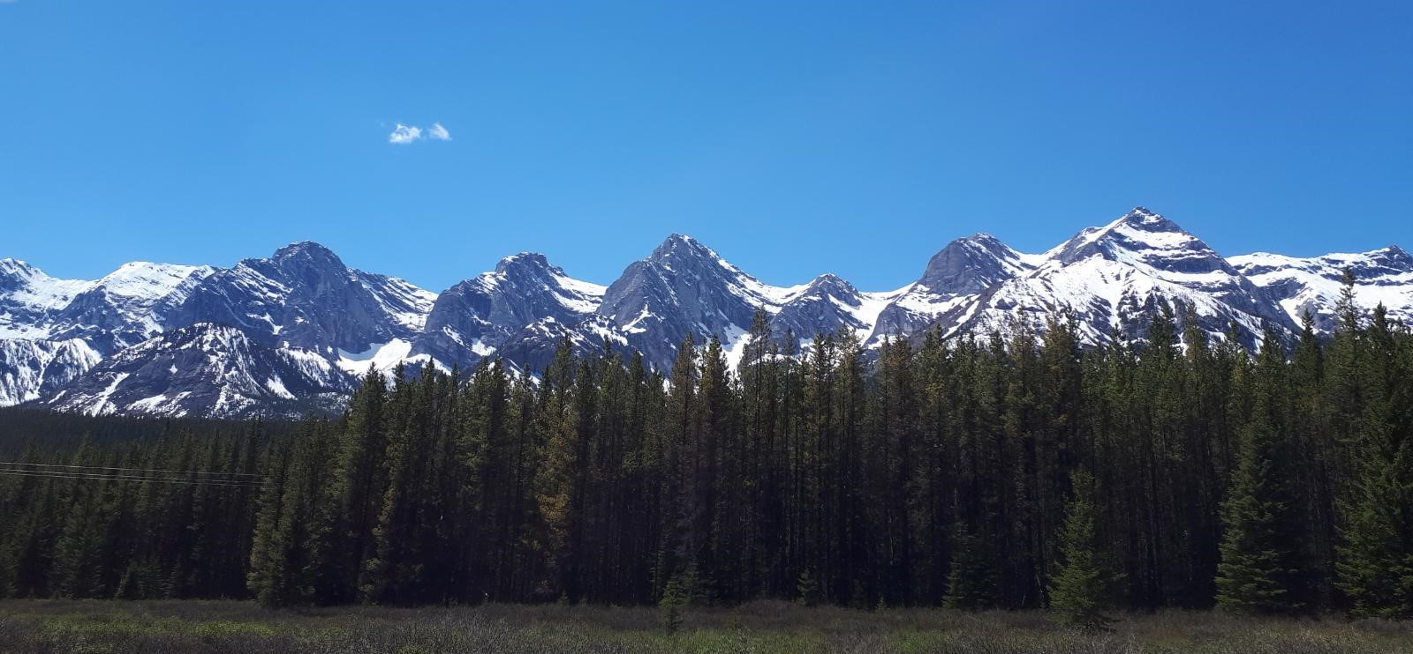
Spruce Beetle Repellency Trial
Upper Elk Valley

Slide 18
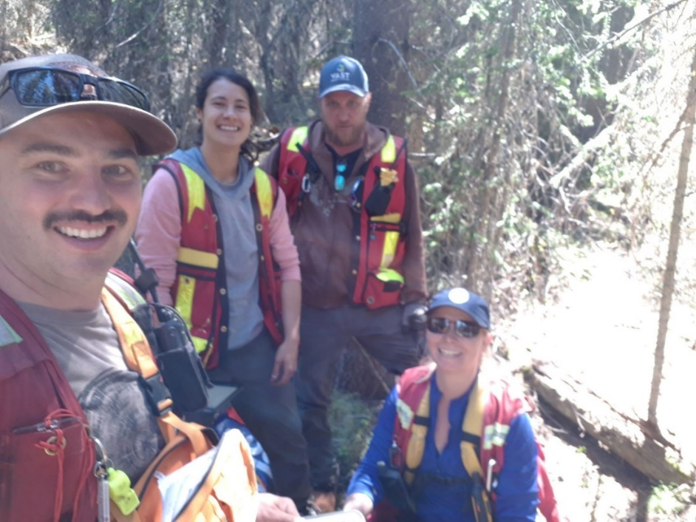
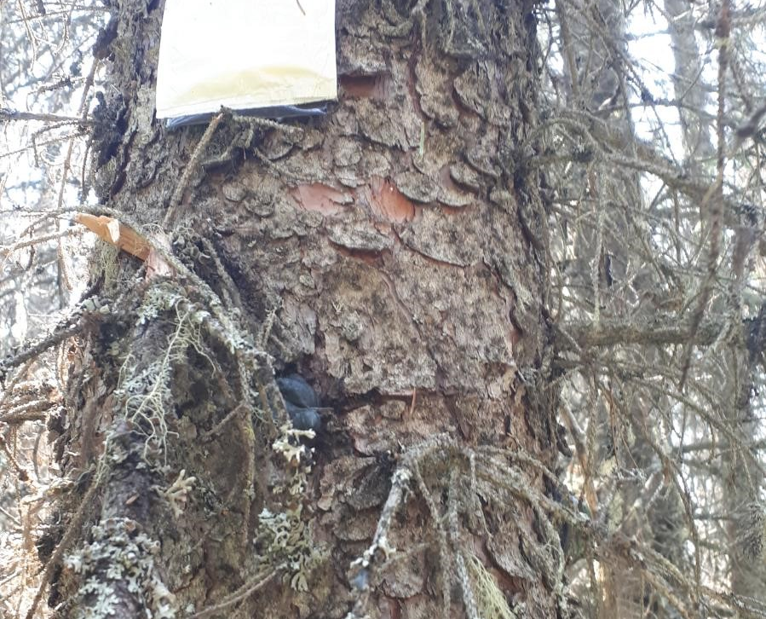
Repellency trial
MCH anti-aggregant, (methylcyclohexenone) =tree is already full
Non-host smells = makes tree smell like something else (not right host)
Floral (acetophenone)
Cut Grass- Green Leaf Volatiles
Mushroom – smell that attracts biting insects (1-octen-3-ol)
Maple (Acer kairomone blend) (AKB)

Slide 19
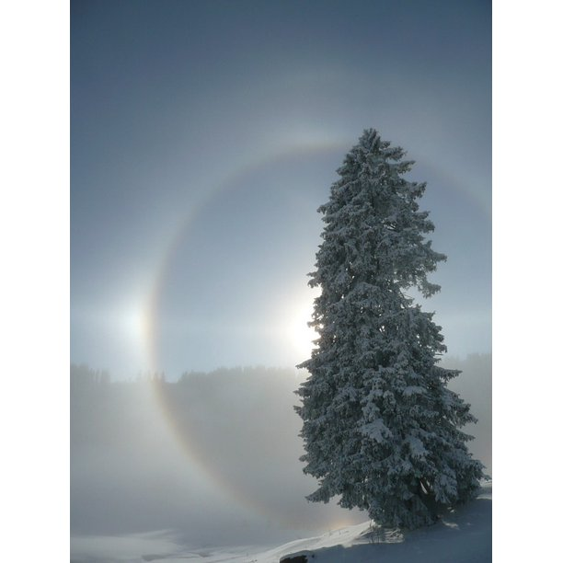
Spruce beetle repellency trial summary: spruce beetle percent attack and spill over by treatment
“Halo effect”

Slide 20
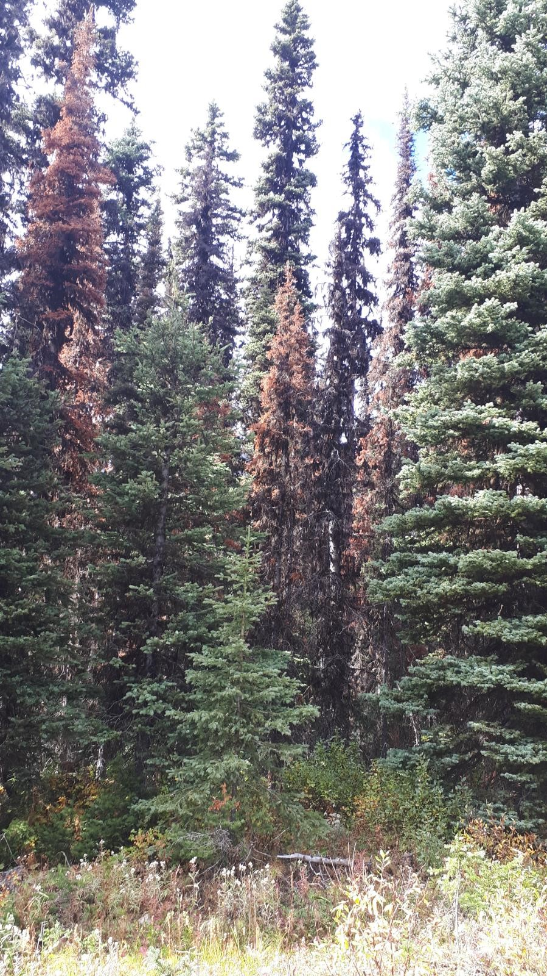
Western balsam bark beetle 2010-2021
AR doubled; RE 6X; GO & IN always high

Slide 21
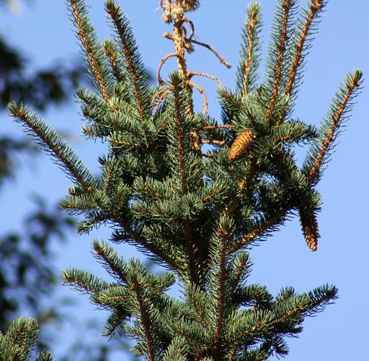
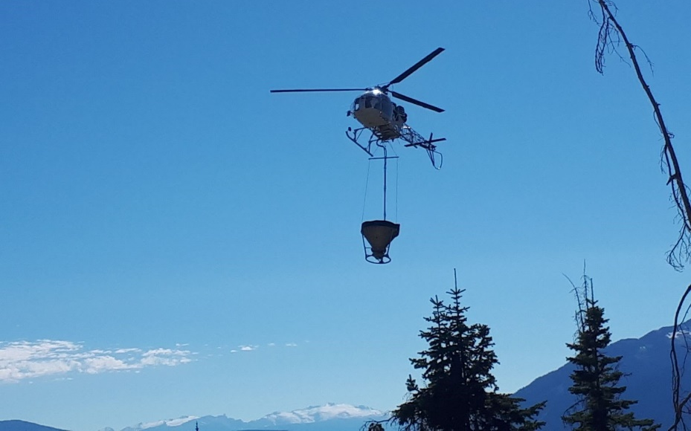
Monitoring: Fertilization & FH
2020: 6,000 ha (3,000ha in each of TFL 55 & 56)
2021: 4,500 ha Revelstoke TSA
Targeted Sx, Fd, Cw stands 15-50 years old
Selected Sx stands with minimal IWS however
Fertilization increases leader height – more desirable to weevil – more impact expected
Impact plots to be remeasured in 5 years time

Slide 22
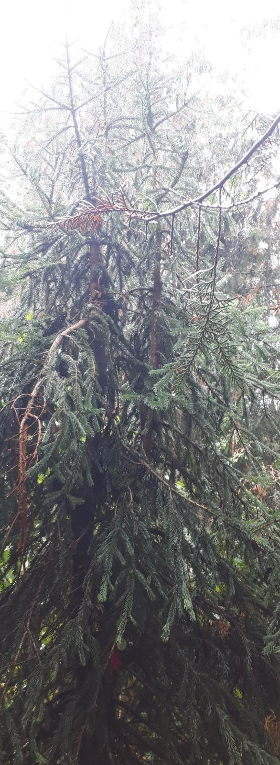
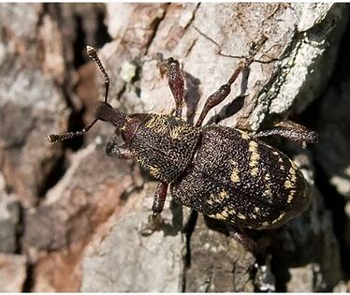
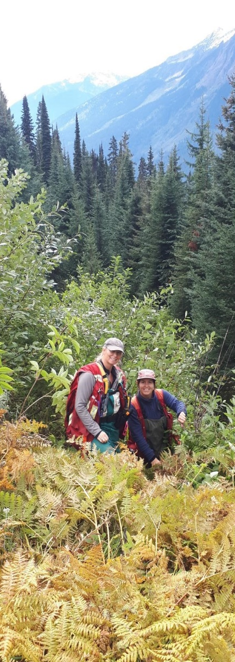
Fertilization and Forest Health
Impact Plots
Revelstoke
Established 22 plots (measured, mapped and tagged 278 trees)
September 2021

Slide 23
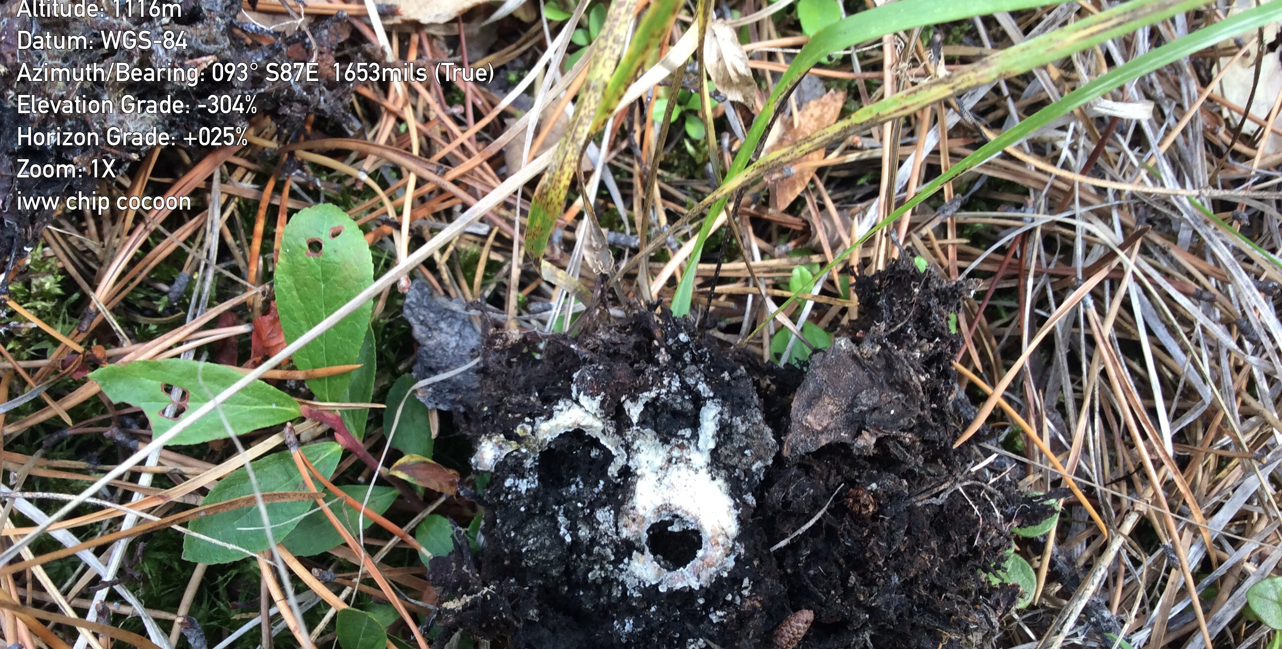
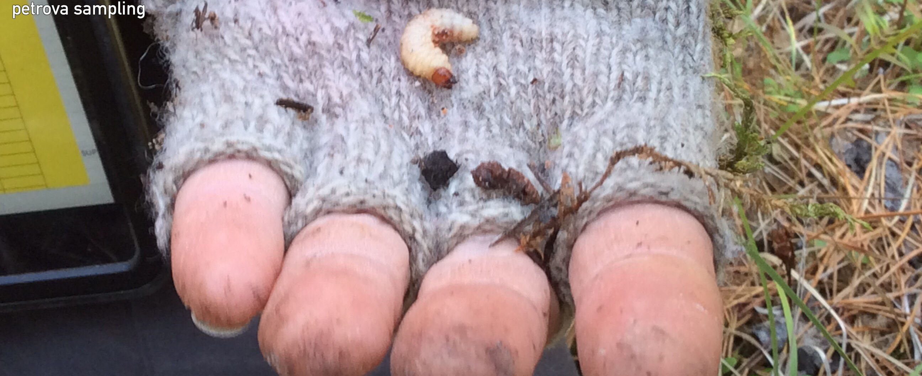
Monitoring: Impacts of pests of young lodgepole pine stands remeasurements
7 PSPs established in 1999 and 2000
Last remeasurement in 2016
Now 22 years of data
High incidence of
  ISQ (Sequoia Pitch Moth)
  IWW (Warrens root collar weevil)
  Report still coming

Slide 24
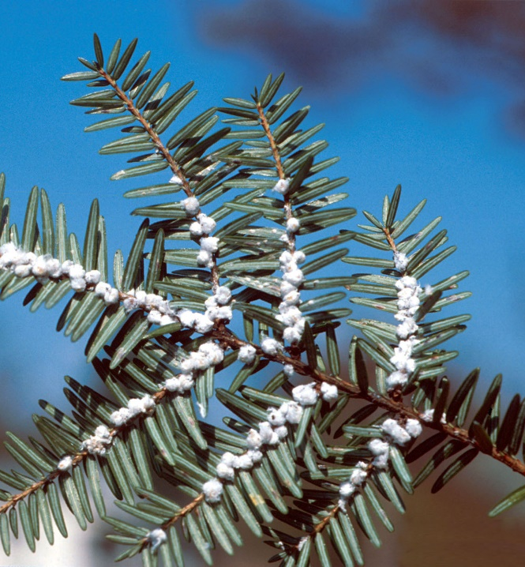
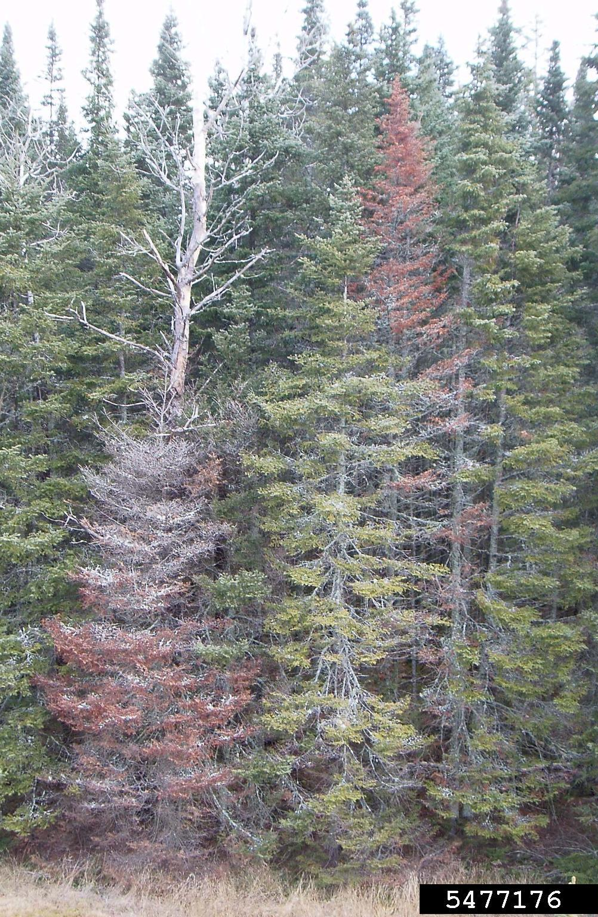
Monitoring: BWA: Research Portfolio Request:
Ecosystem Health and Disturbance
Title: Invasive balsam woolly adelgid range expansion and impacts
Description: Establish permanent sample plot in southern BC to assess impact of BWA in established areas.

Slide 25
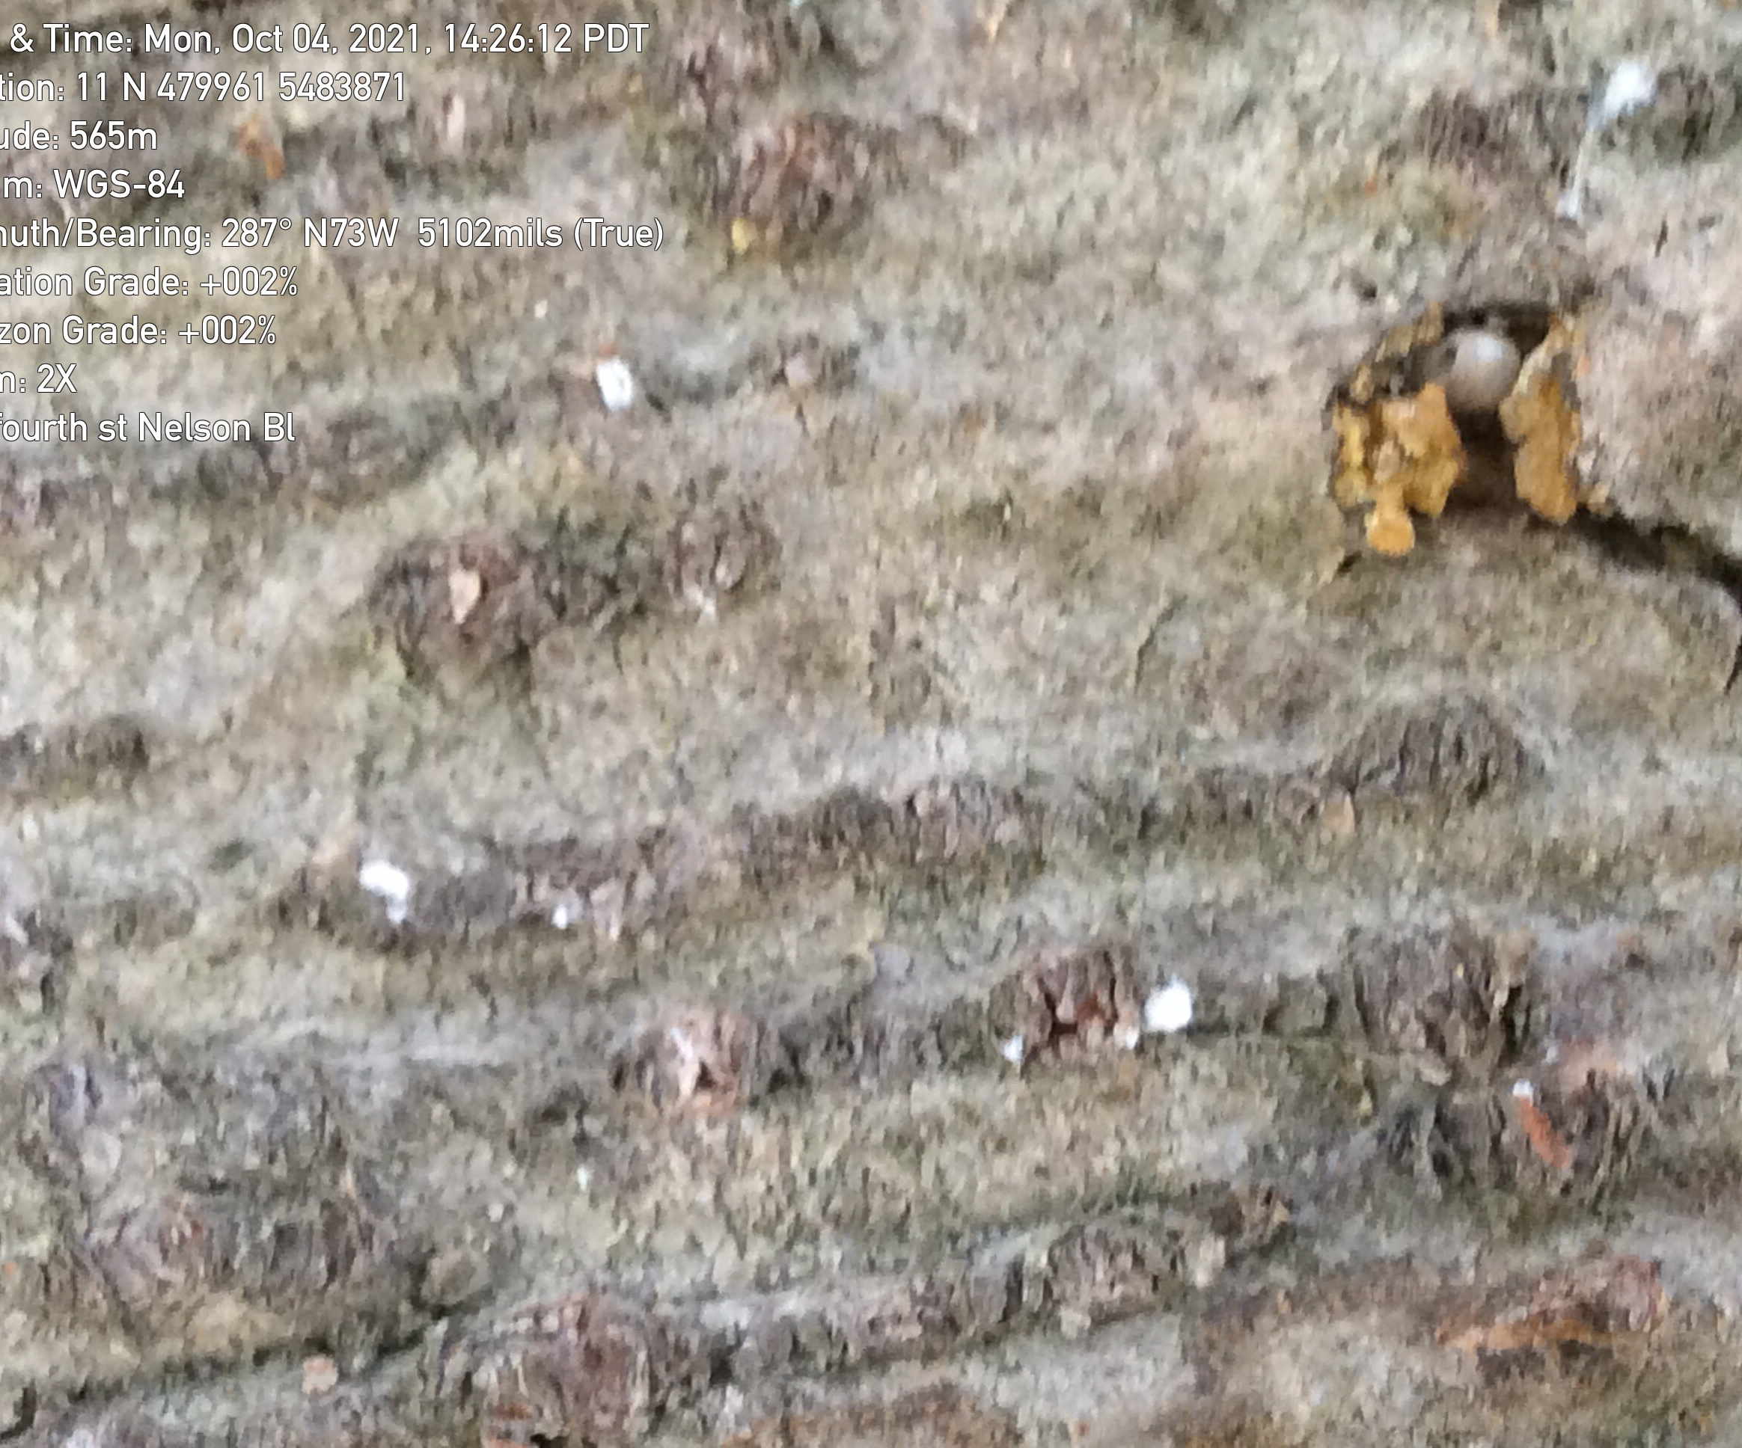
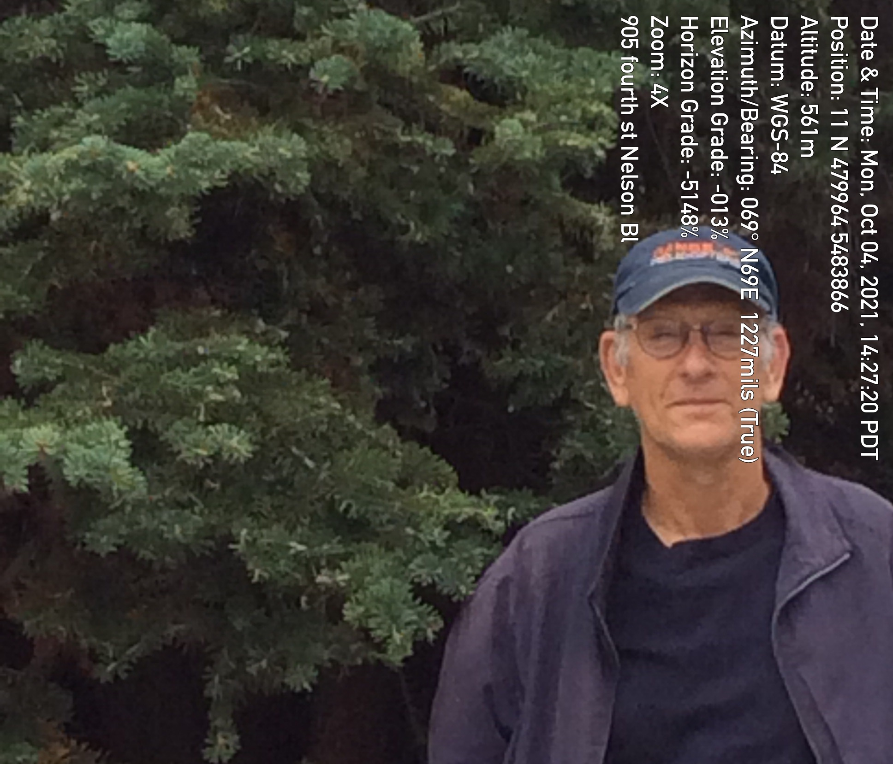
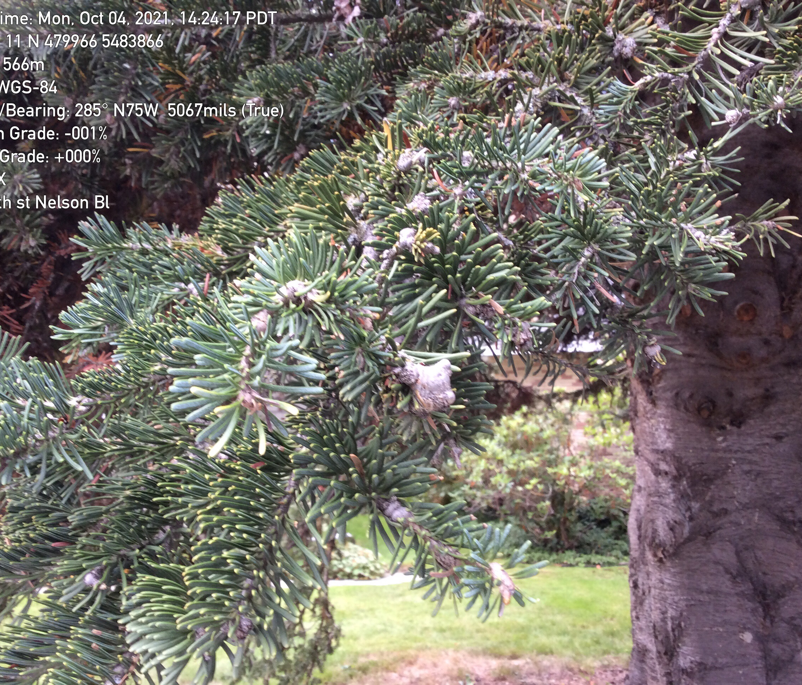
Invasive: Balsam woolly adelgid
Expansion of known range: new occurrence in Nelson (furthest East) – Art Stock
Known populations: Rossland, Grand Forks (Phoenix Ski Hill; Jewel Lake near Greenwood)

Slide 26
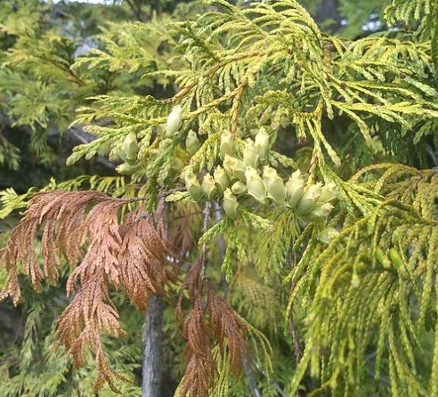
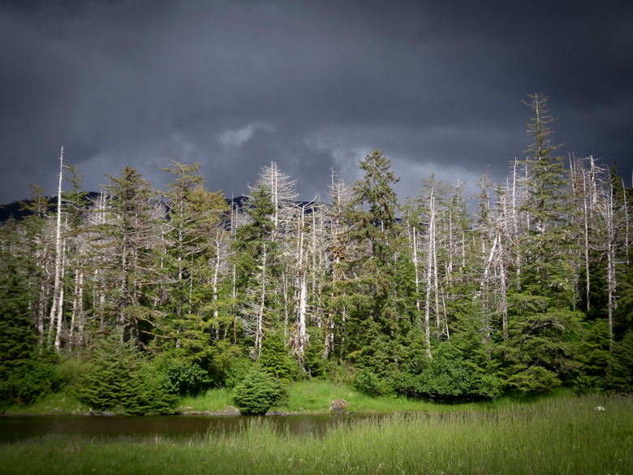
Monitoring: Cedar Dieback
Project, “Investigating the extent and possible causes of western redcedar dieback throughout its range”. Melissa Joy Fischer (Colville WA) melissa.fischer@dnr.wa.gov
Take a GPS at a site where you are seeing western redcedar dieback.
Cedar dieback is caused by a variety of factors.
Typically, insects and disease aren’t the primary mortality agent for cedar.
Cedar is very sensitive to climate change so increasing in temperature and drought stress can lower the limits of where both insects and disease effect the trees.
https://sflonews.wordpress.com/2021/04/20/cooperative-forest-health-alert-western-redcedar-dieback-in-the-northwest/

Slide 27
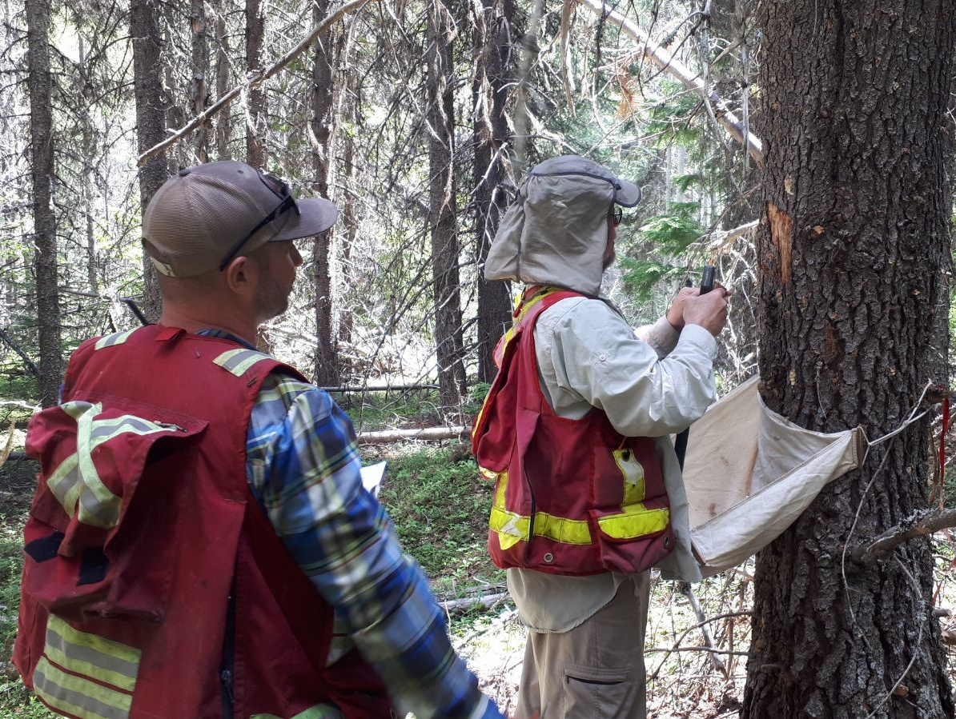
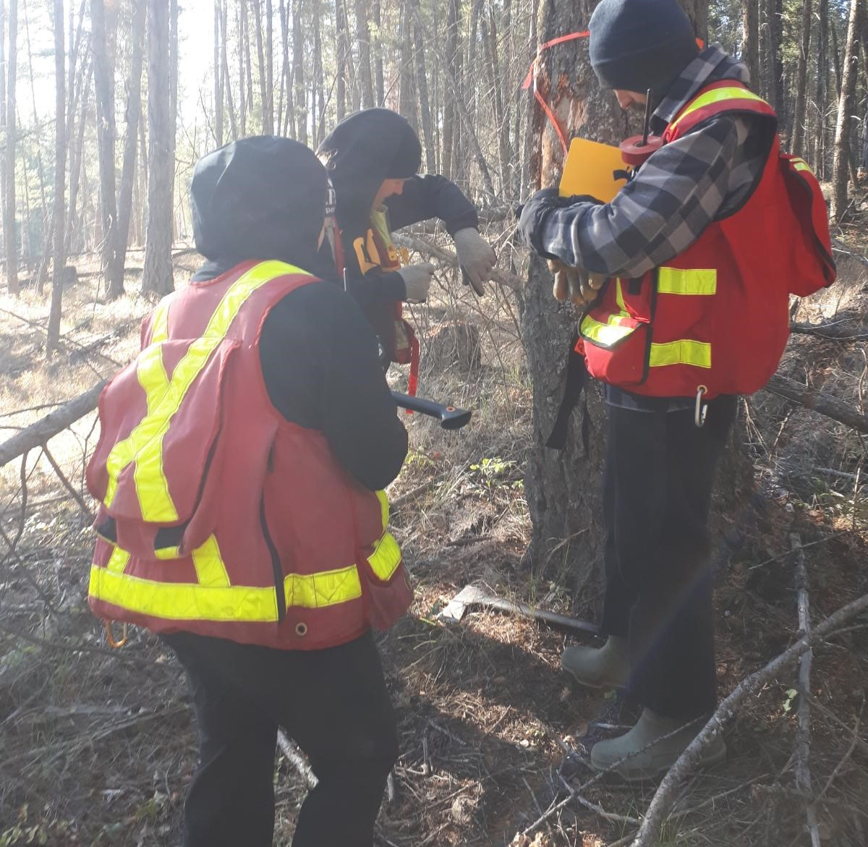
Training & Extension
Bark Beetle Training
  In person and Skype training – ground surveys, management and detailed aerial surveys
YSM Training
  Nelson June 7-8, 2021
  Provincial updates to manual
Bi-annual Regional FH Meetings/ Field Trips, daily/ weekly discussions with District staff
Many TSA and Woodlots working group meetings
Many field site visits: Highly controversial areas, letter writing campaigns, Minster letters, etc.
  IBD (Columbia Wetlands; Mnt Seven; Galtons, etc.)
  IBS (Elk Valley; Revelstoke Glacier National Park)
  IBM (Cranbrook Watershed/ Mnt and Baker Mnt)
  New implementation of Blanket Salvage Permits DRM

Slide 28

Successes and challenges
Many, many successes as noted already…
Great buy in to forest health program from Regional Managers, dedicating District and Regional resources – base funding for Research Technician
District support for projects
Heat dome – collapse of defoliators building populations
Budget surpluses

Slide 29
Successes and challenges
COVID – travel restrictions/ precautions
Smoke/ fires
  delays in field work
  difficulty getting both internal staff and contractors
Resources: Shared technician DRM and Region – difficulty finding qualified people

